Slide 1

DSC190: Machine Learning with Few Labels
Unsupervised Learning
Zhiting Hu
Lecture 9, October 18, 2024

Slide 2
Outline
Unsupervised Learning
Two paper presentations
  Yuxuan Zhang: GQA: Training Generalized Multi-Query Transformer Models from Multi-Head Checkpoints
  Xinle Yu: Continuous Adaptation via Meta-Learning in Nonstationary and Competitive Environments

Slide 3
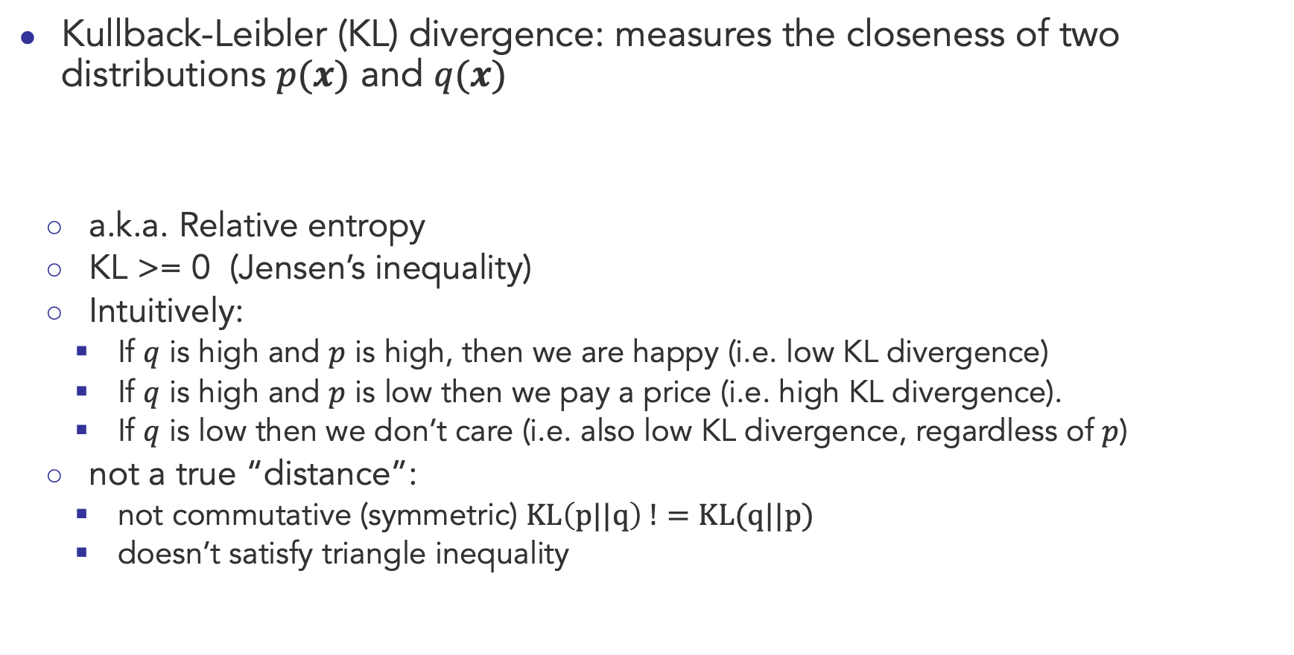
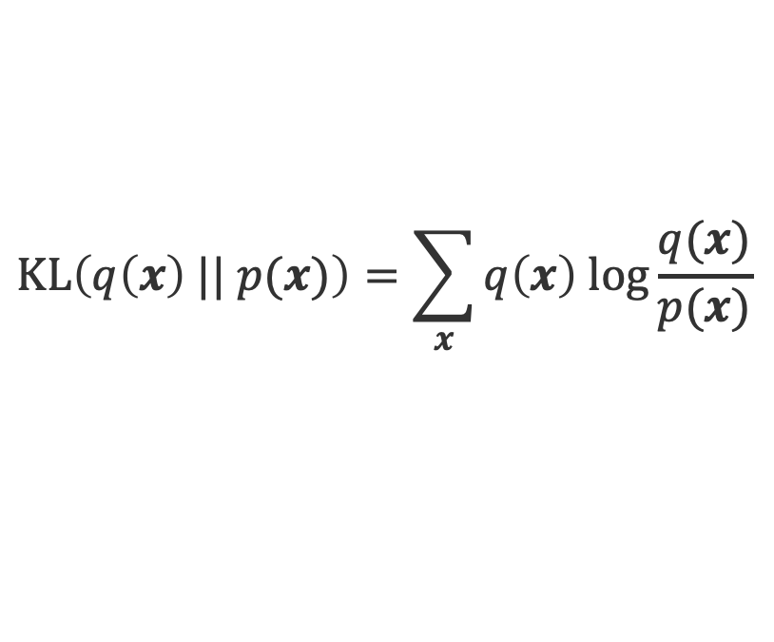
Recap: KL Divergence
Kullback-Leibler (KL) divergence: measures the closeness of two distributions $p(x)$ and $q(x)$
  a.k.a. Relative entropy
  KL >= 0 (Jensen’s inequality)
  Intuitively:
    If $q$ is high and $p$ is high, then we are happy (i.e. low KL divergence)
    If $q$ is high and $p$ is low then we pay a price (i.e. high KL divergence).
    If $q$ is low then we don’t care (i.e. also low KL divergence, regardless of $p$)
  not a true “distance”:
    not commutative (symmetric) $KL\left(p||q\right) !=KL(q||p)$
    doesn’t satisfy triangle inequality
$$KL\left(q\left(x\right) || p(x)\right)=\sum_{x}{q\left(x\right) log\frac{q(x)}{p(x)}}$$

Slide 4
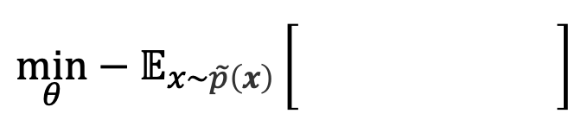
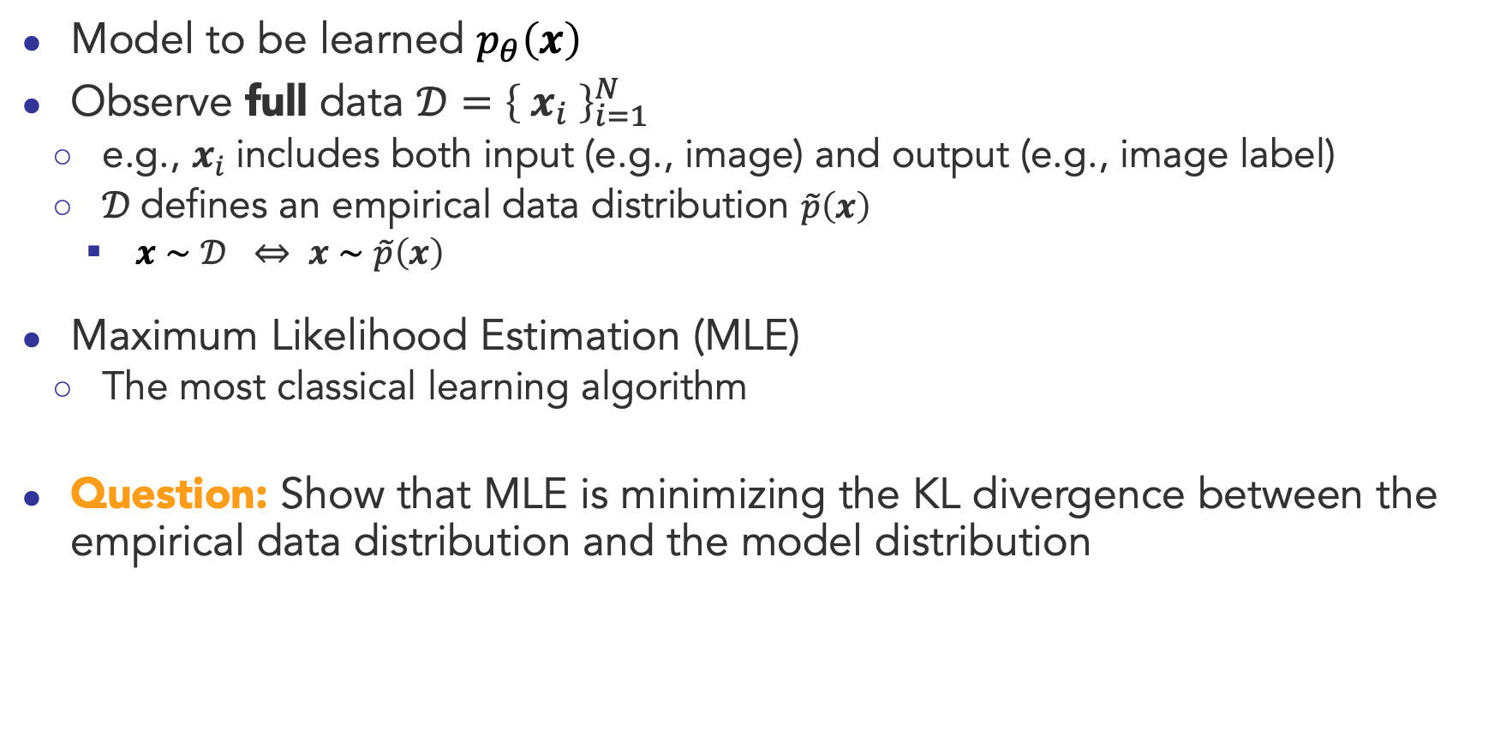

Supervised Learning
Model to be learned $p_{θ}\left(x\right)$
Observe full data $𝒟={\left\{ x_{i} \right\}}_{i=1}^{N}$
  e.g., $x_{i}$includes both input (e.g., image) and output (e.g., image label)
  $𝒟$defines an empirical data distribution $\tilde{p}\left(x\right)$
    $x∼𝒟 ⇔ x∼\tilde{p}\left(x\right)$
Maximum Likelihood Estimation (MLE)
  The most classical learning algorithm
Question: Show that MLE is minimizing the KL divergence between the empirical data distribution and the model distribution
$$\min_{θ}−𝔼_{x∼\tilde{p}\left(x\right)}\left[\frac{1 }{} \right]$$
$$log p_{θ}(x)$$

Slide 5
Supervised Learning
Model to be learned $p_{θ}\left(x\right)$
Observe full data $𝒟={\left\{ x_{i} \right\}}_{i=1}^{N}$
  e.g., $x_{i}$includes both input (e.g., image) and output (e.g., image label)
  $𝒟$defines an empirical data distribution $\tilde{p}\left(x\right)$
    $x∼𝒟 ⇔ x∼\tilde{p}\left(x\right)$
Maximum Likelihood Estimation (MLE)
  The most classical learning algorithm
Question: Show that MLE is minimizing the KL divergence between the empirical data distribution and the model distribution
$$\min_{θ}−𝔼_{x∼\tilde{p}\left(x\right)}\left[\frac{1 }{} \right]$$
$$log p_{θ}(x)$$
$$KL\left(\tilde{p}(x) || p_{θ}(x)\right)=−𝔼_{\tilde{p}\left(x\right)}\left[ log{ p}_{θ}\left(x\right) \right]+H(\tilde{p}(x))$$
Cross entropy

Slide 6

Unsupervised Learning
Each data instance is partitioned into two parts:
  observed variables $x$
  latent (unobserved) variables $z$
Want to learn a model $p_{θ}\left(x,z\right)$
[Content adapted from CMU 10-708]

Slide 7
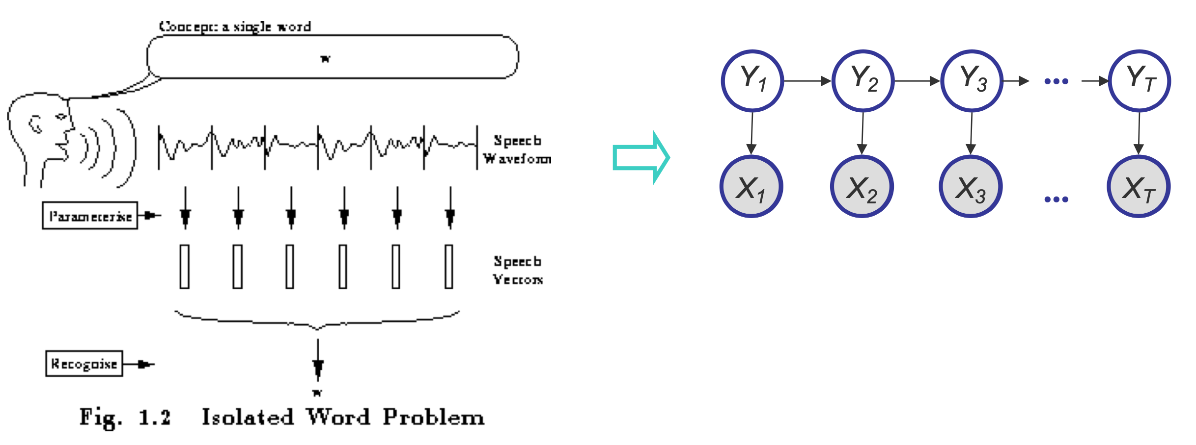
Latent (unobserved) variables
A variable can be unobserved (latent) because:
  imaginary quantity: meant to provide some simplified and abstractive view of the data generation process
    e.g., speech recognition models, mixture models, ...

Slide 8
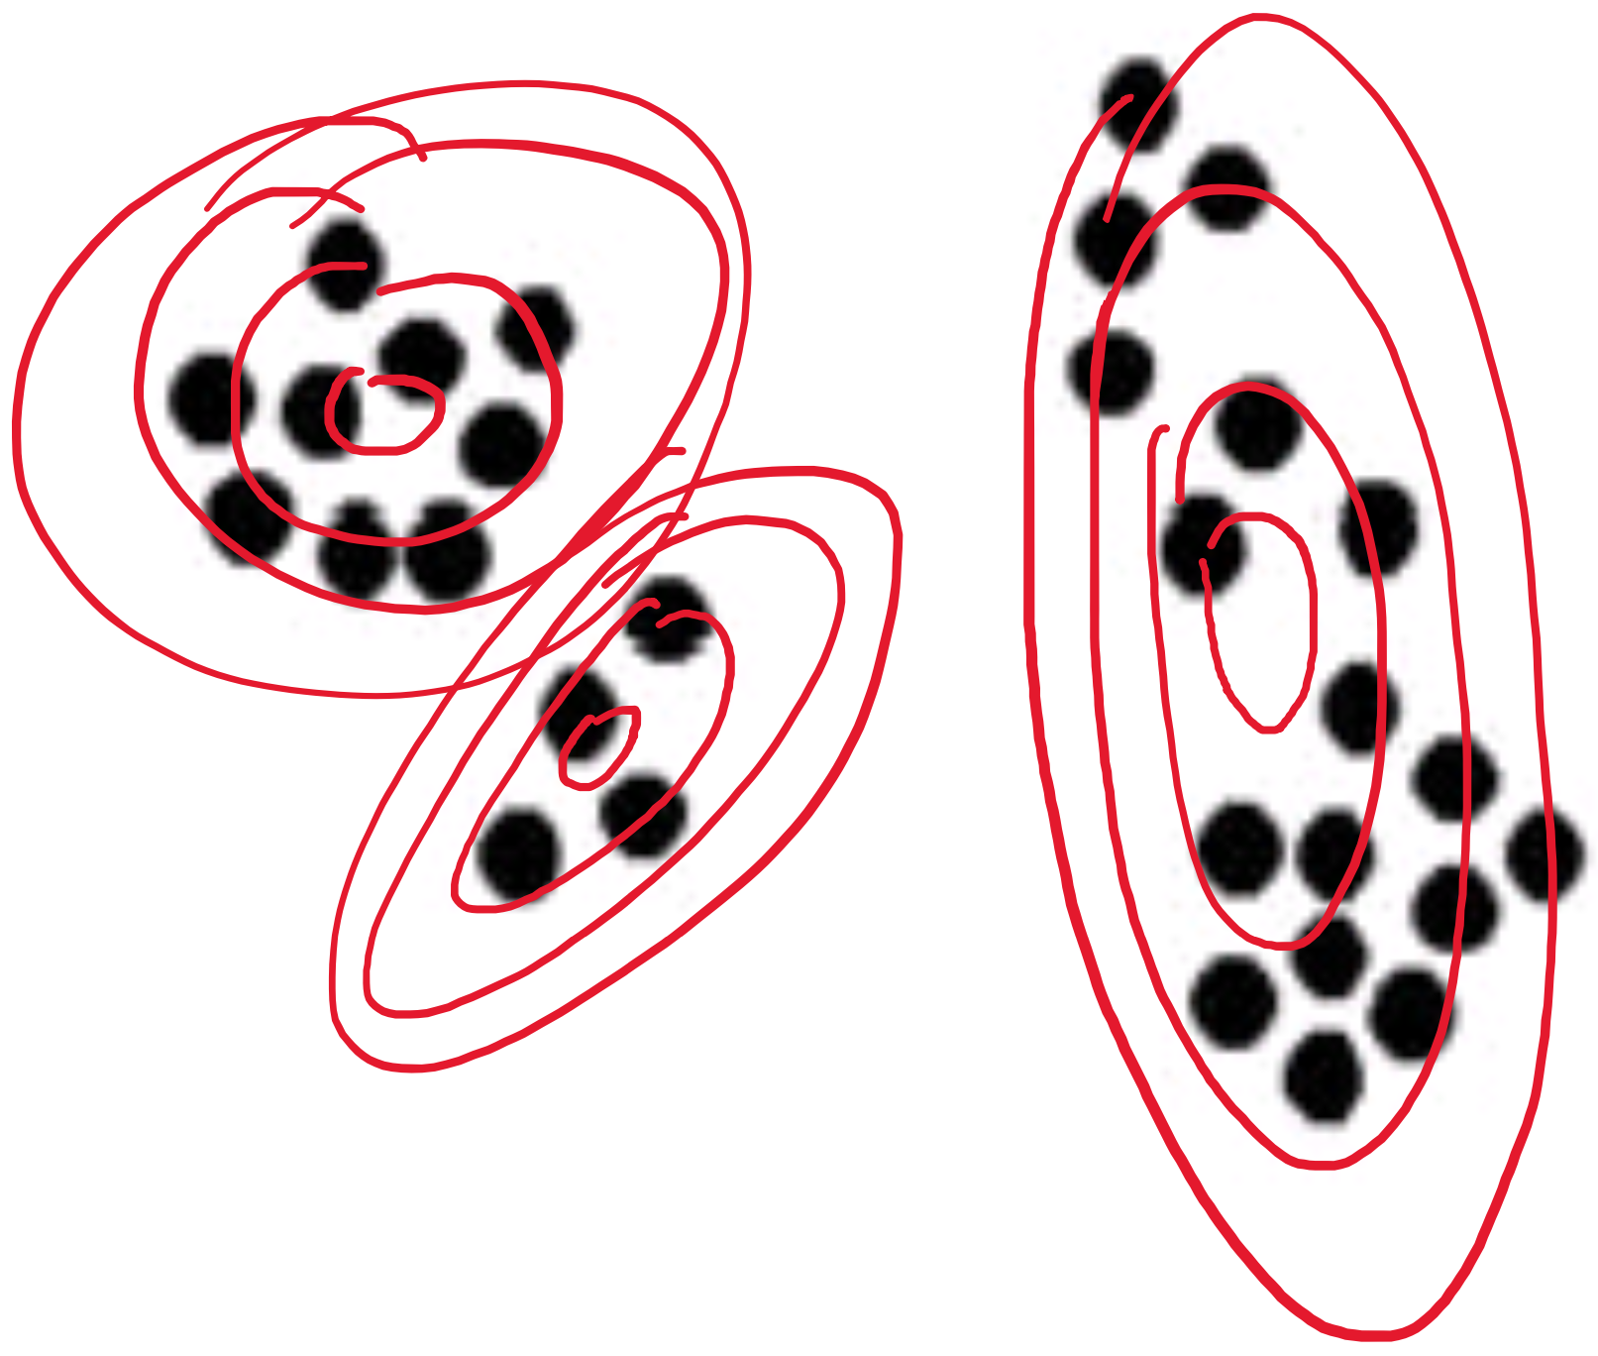
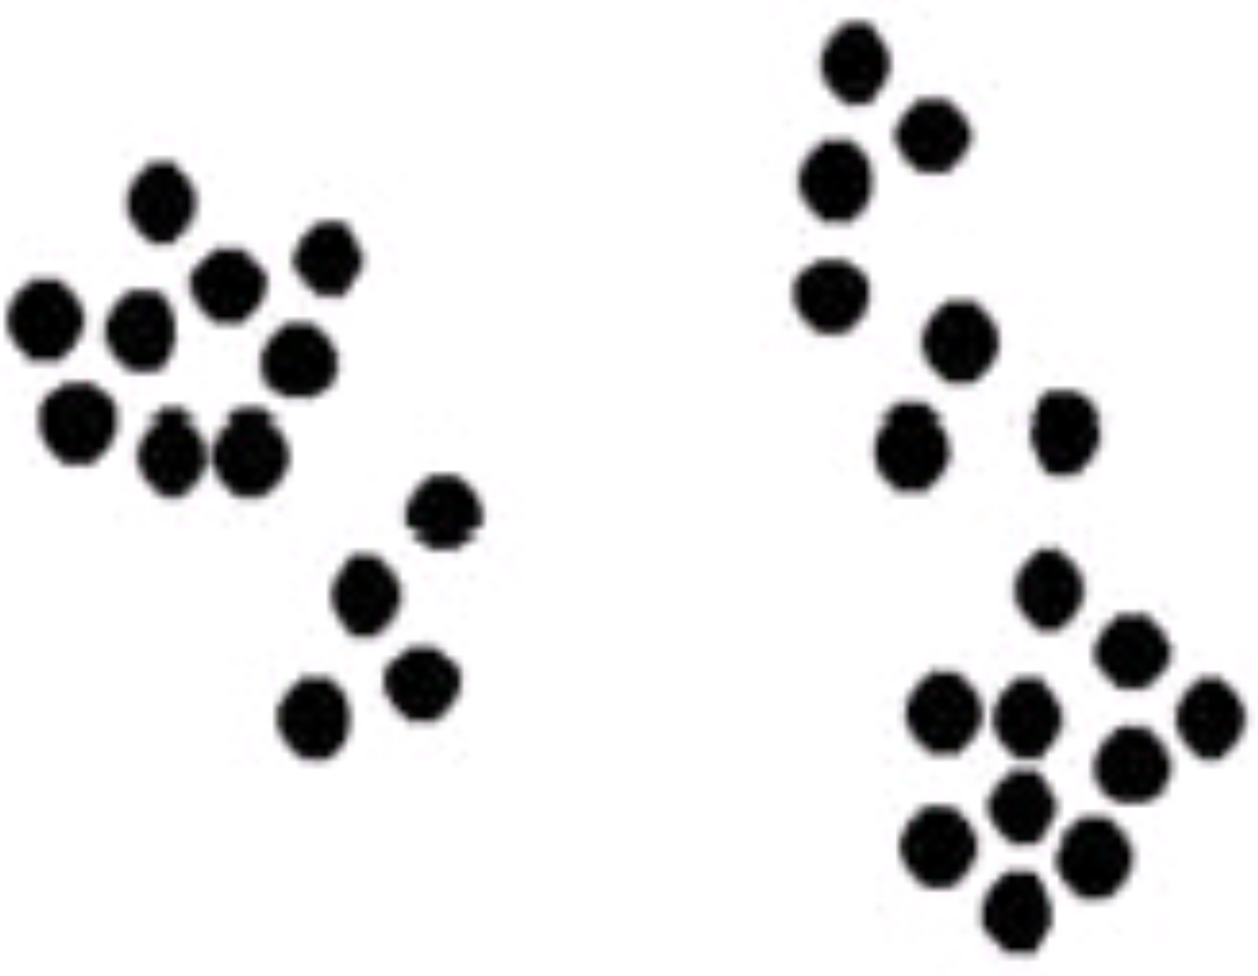
Latent (unobserved) variables
A variable can be unobserved (latent) because:
  imaginary quantity: meant to provide some simplified and abstractive view of the data generation process
    e.g., speech recognition models, mixture models, ...

Slide 9
Latent (unobserved) variables
A variable can be unobserved (latent) because:
  imaginary quantity: meant to provide some simplified and abstractive view of the data generation process
    e.g., speech recognition models, mixture models, ...
  a real-world object (and/or phenomena), but difficult or impossible to measure
    e.g., the temperature of a star, causes of a disease, evolutionary ancestors ...
  a real-world object (and/or phenomena), but sometimes wasn’t measured, because of faulty sensors, etc.
Discrete latent variables can be used to partition/cluster data into sub- groups
Continuous latent variables (factors) can be used for dimensionality reduction (e.g., factor analysis, etc.)

Slide 10
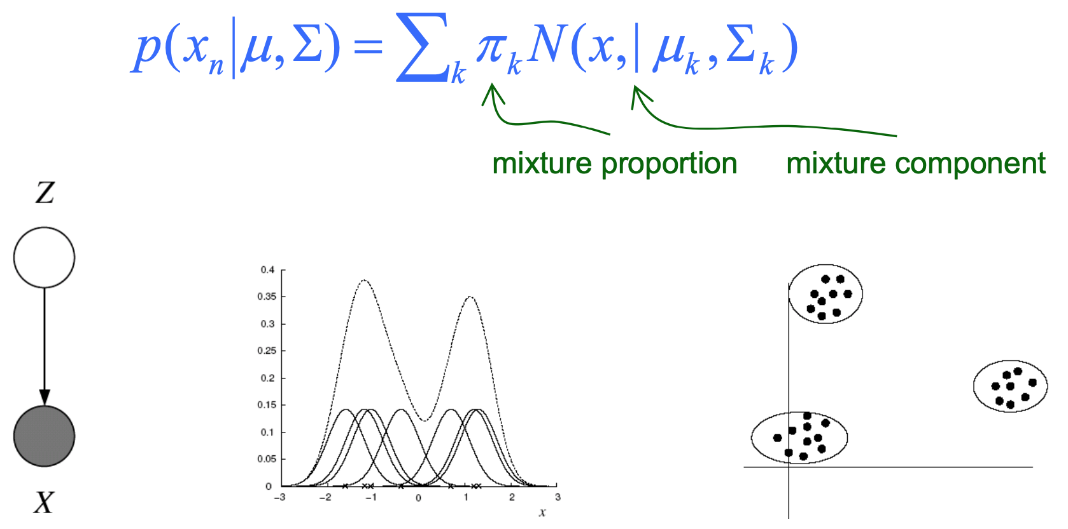
Example: Gaussian Mixture Models (GMMs)
Consider a mixture of K Gaussian components:
This model can be used for unsupervised clustering.
  This model has been used to discover new kinds of stars in astronomical data, etc.

Slide 11
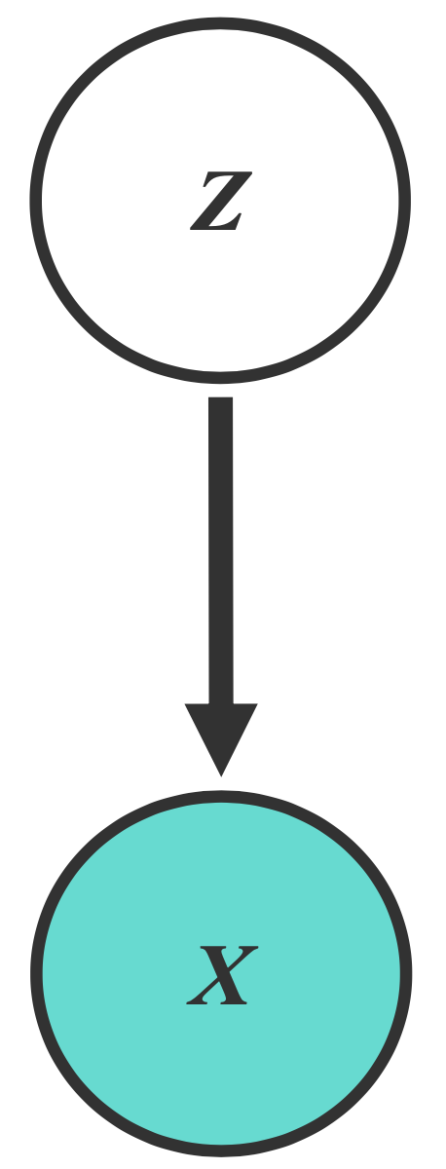
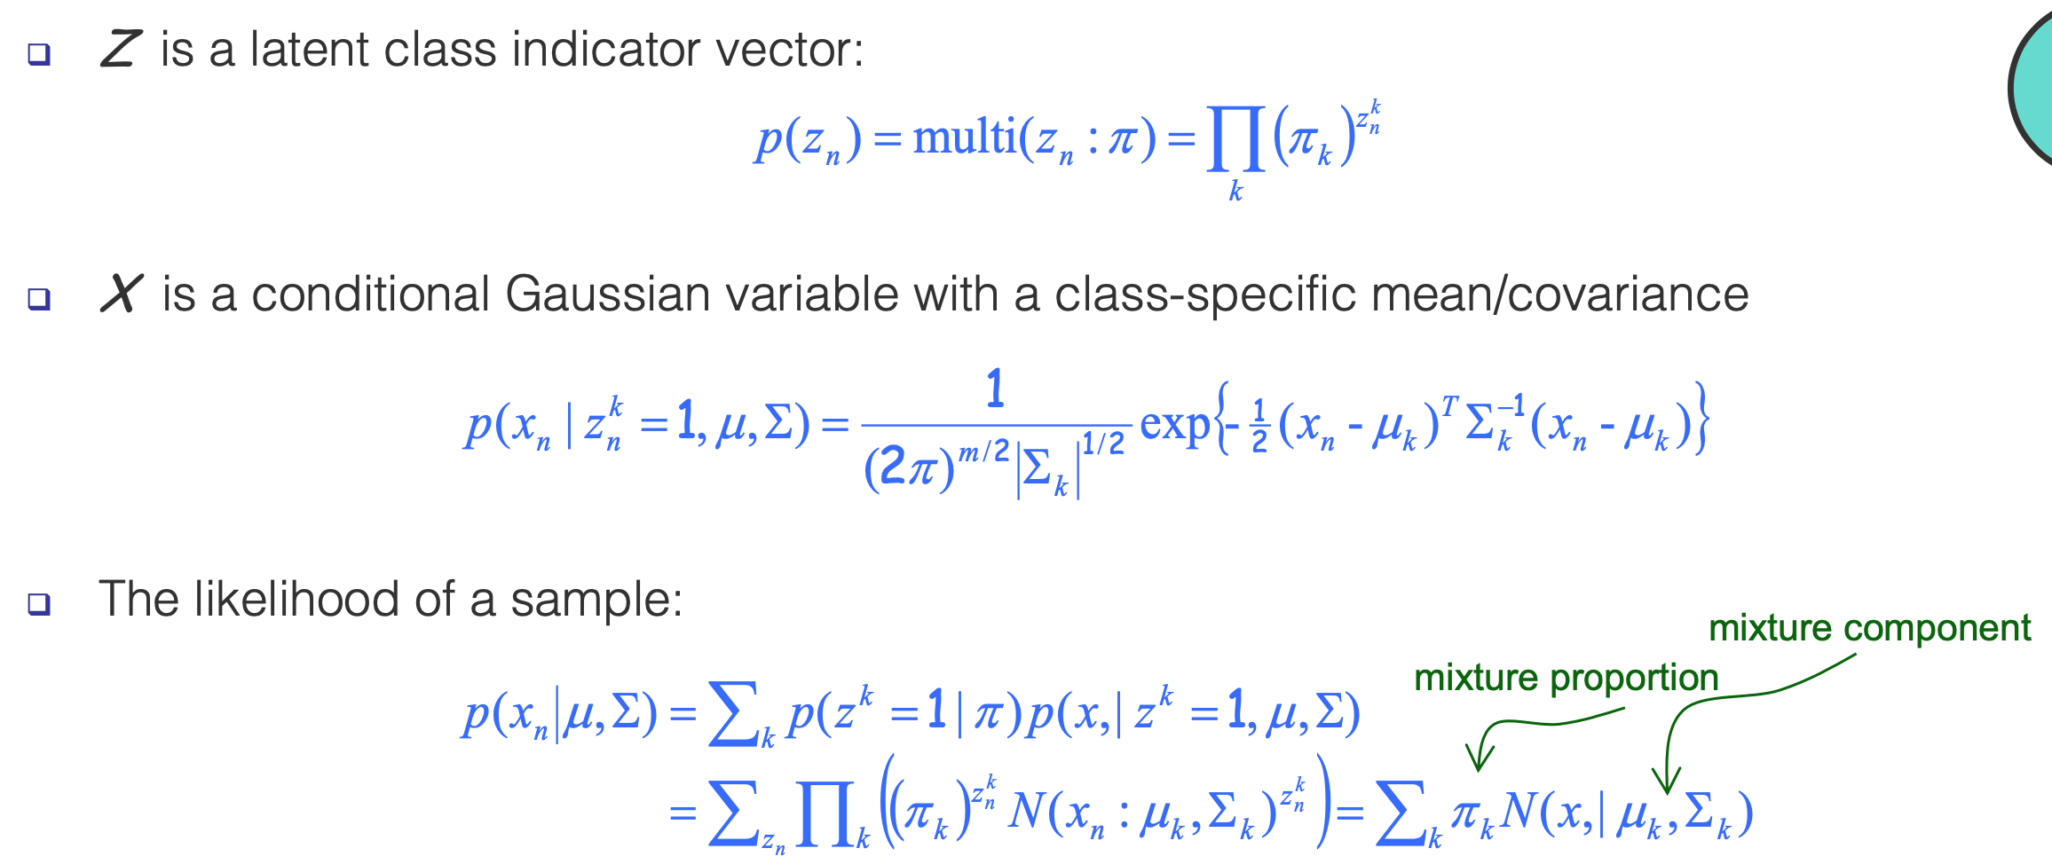
Example: Gaussian Mixture Models (GMMs)
Consider a mixture of K Gaussian components:
Parameters to be learned:
Notes:
Parameters to be learned: mixture proportion, mixture components

Slide 12
Example: Gaussian Mixture Models (GMMs)
Consider a mixture of K Gaussian components:
Parameters to be learned:
Notes:
Parameters to be learned: mixture proportion, mixture components

Slide 13
Example: Gaussian Mixture Models (GMMs)
Consider a mixture of K Gaussian components:
Parameters to be learned:
Notes:
Parameters to be learned: mixture proportion, mixture components

Slide 14
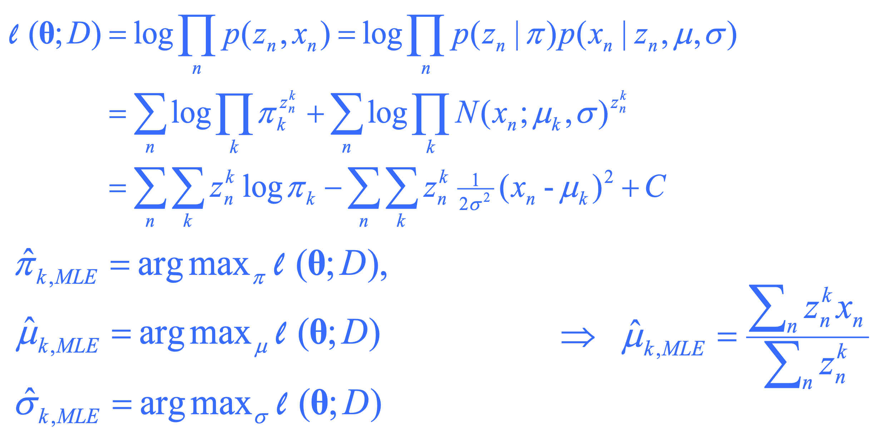

Example: Gaussian Mixture Models (GMMs)
Consider a mixture of K Gaussian components:
Recall MLE for completely observed data
  Data log-likelihood:
  MLE:
What if we do not know $z_{n}$?

Slide 15
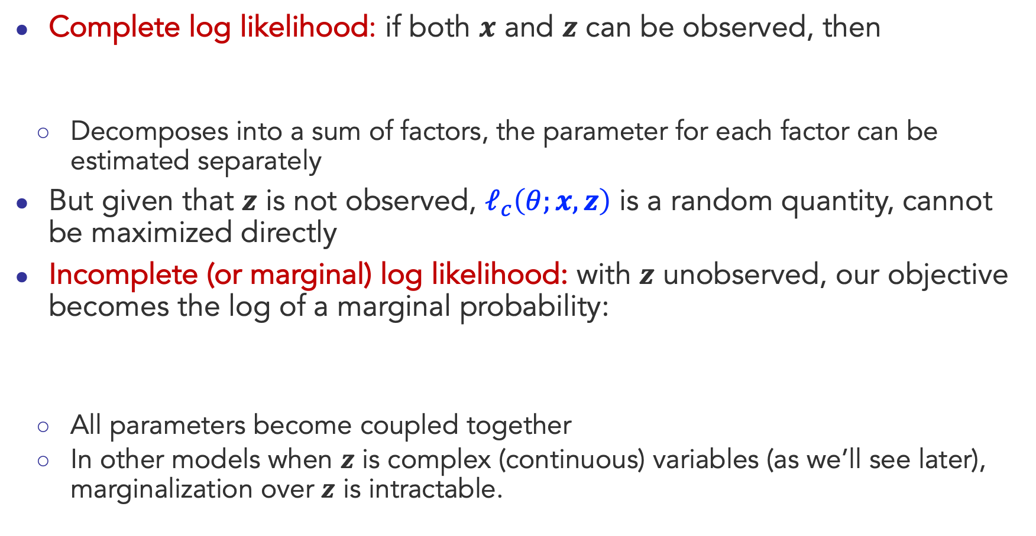
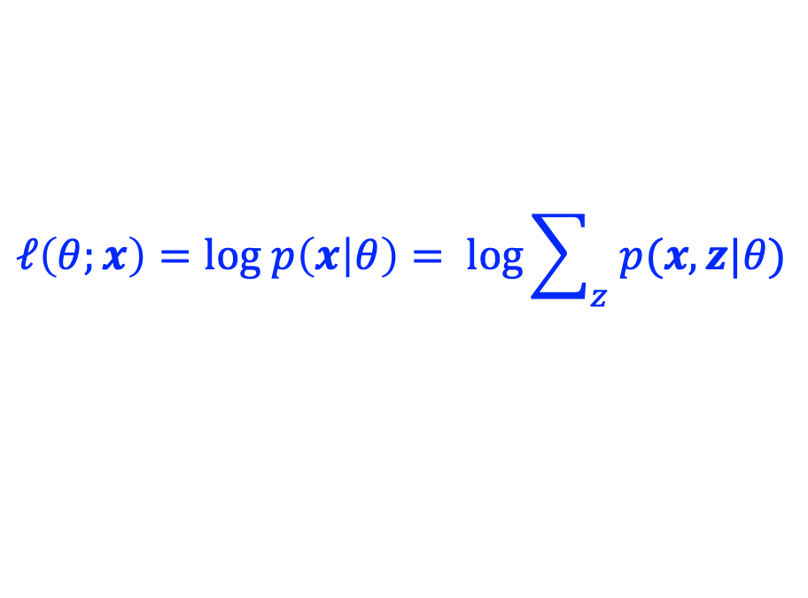
Why is Learning Harder?
Complete log likelihood: if both $x$ and $z$ can be observed, then
  Decomposes into a sum of factors, the parameter for each factor can be estimated separately
But given that $z$ is not observed, $ℓ_{c}\left(θ;x,z\right)$ is a random quantity, cannot be maximized directly
Incomplete (or marginal) log likelihood: with $z$ unobserved, our objective becomes the log of a marginal probability:
  All parameters become coupled together
  In other models when $z$ is complex (continuous) variables (as we’ll see later), marginalization over $z$ is intractable.
$$ℓ_{c}\left(θ;x,z\right)=log p\left(x, z | θ\right)= log p\left(z | θ_{z}\right)+log p(x|z,θ_{x})$$
$$ℓ\left(θ;x\right)=log p\left(x | θ\right)= log\sum_{z}{p(x,z|θ)}$$

Slide 16

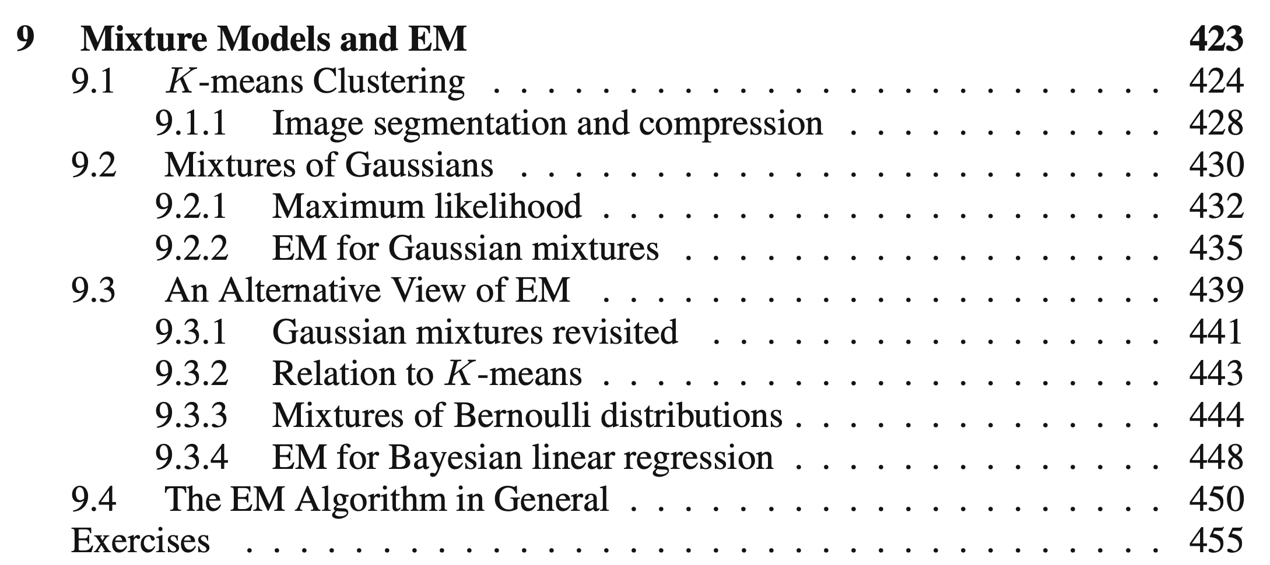
Expectation Maximization (EM)
This class

Slide 17
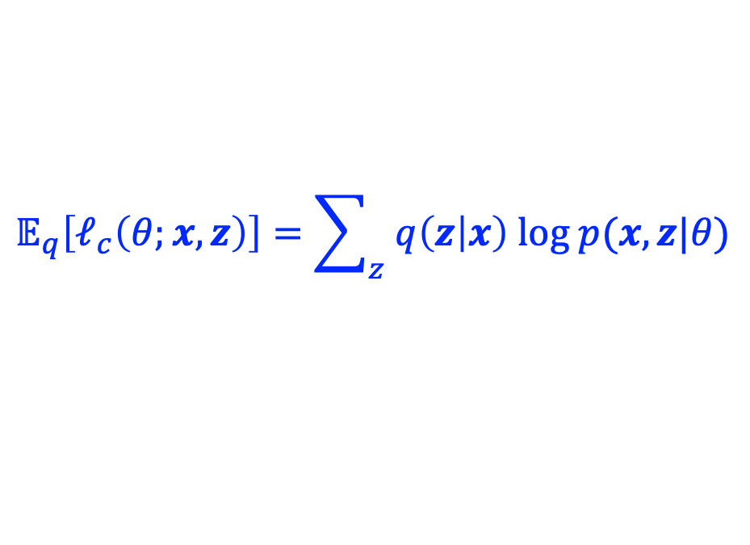
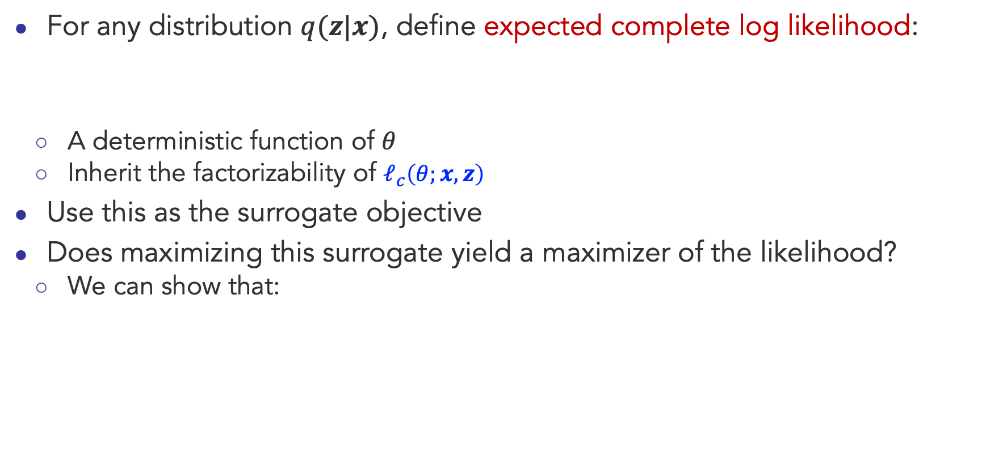

Expectation Maximization (EM)
For any distribution $q(z|x)$, define expected complete log likelihood:
  A deterministic function of $θ$
  Inherit the factorizability of $ℓ_{c}\left(θ;x,z\right)$
Use this as the surrogate objective
Does maximizing this surrogate yield a maximizer of the likelihood?
  We can show that:
$$𝔼_{q}\left[ℓ_{c}\left(θ;x,z\right)\right]=\sum_{z}{q\left(z | x\right) log p(x,z|θ)}$$
$ℓ\left(θ;x\right)≥$ $𝔼_{q}\left[ℓ_{c}\left(θ;x,z\right)\right]+H\left(q\right)$

Slide 18


Expectation Maximization (EM)
For any distribution $q(z|x)$, define expected complete log likelihood:
Question: show that
$$𝔼_{q}\left[ℓ_{c}\left(θ;x,z\right)\right]=\sum_{z}{q\left(z | x\right) log p(x,z|θ)}$$
$ℓ\left(θ;x\right)≥$ $𝔼_{q}\left[ℓ_{c}\left(θ;x,z\right)\right]+H\left(q\right)$

Slide 19
Expectation Maximization (EM)
For any distribution $q(z|x)$, define expected complete log likelihood:
Question: show that
$$𝔼_{q}\left[ℓ_{c}\left(θ;x,z\right)\right]=\sum_{z}{q\left(z | x\right) log p(x,z|θ)}$$
$ℓ\left(θ;x\right)≥$ $𝔼_{q}\left[ℓ_{c}\left(θ;x,z\right)\right]+H\left(q\right)$

Slide 20
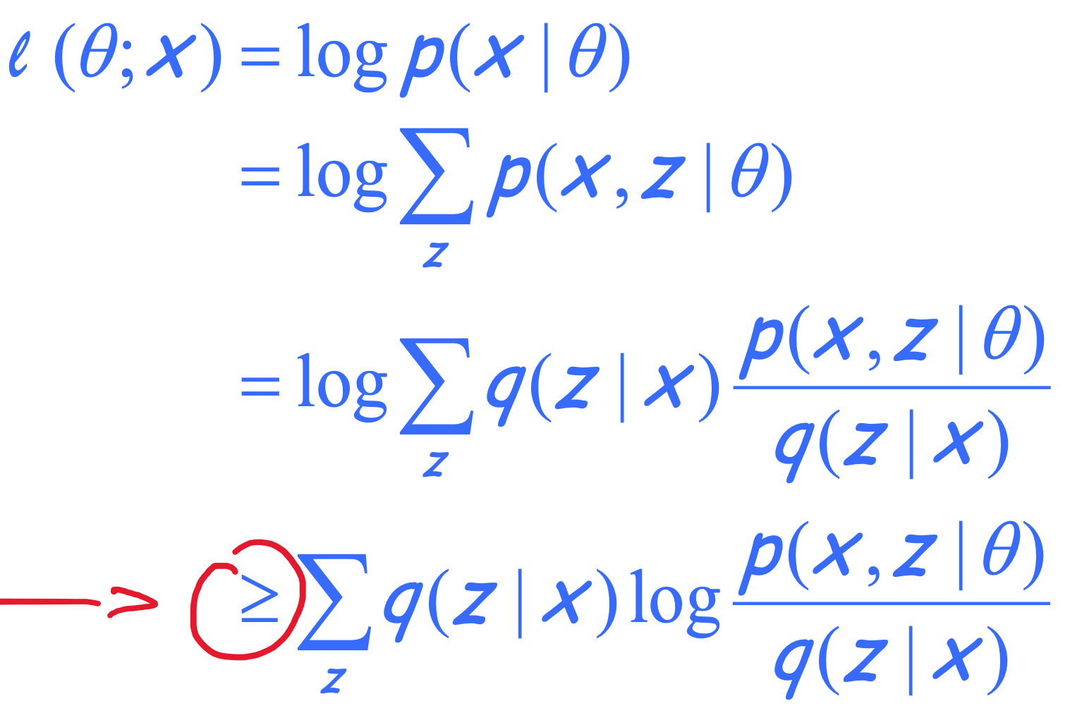
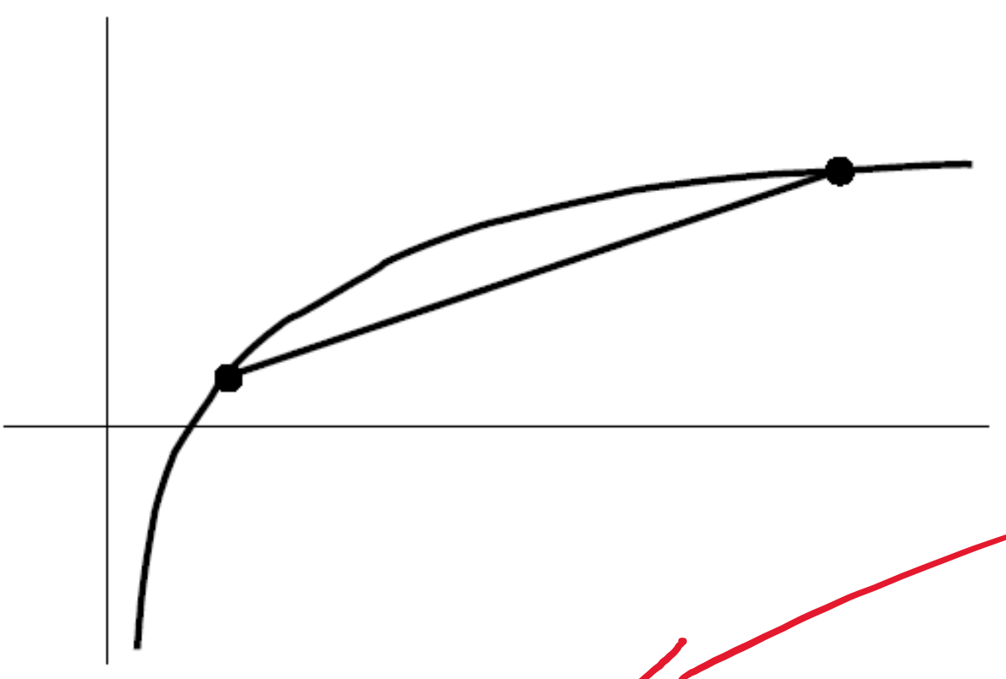
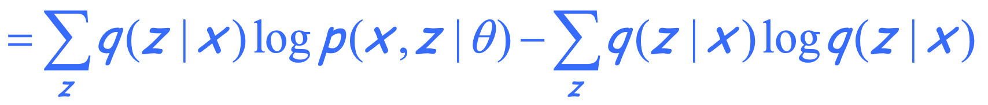



Expectation Maximization (EM)
For any distribution $q(z|x)$, define expected complete log likelihood:
Jensen’s inequality
$$𝔼_{q}\left[ℓ_{c}\left(θ;x,z\right)\right]=\sum_{z}{q\left(z | x\right) log p(x,z|θ)}$$
$$≥$$
Evidence Lower Bound (ELBO)
$$=𝔼_{q}\left[ℓ_{c}\left(θ;x,z\right)\right]+H\left(q\right)$$

Slide 21

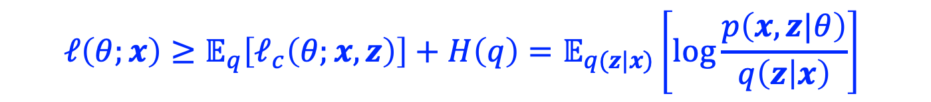
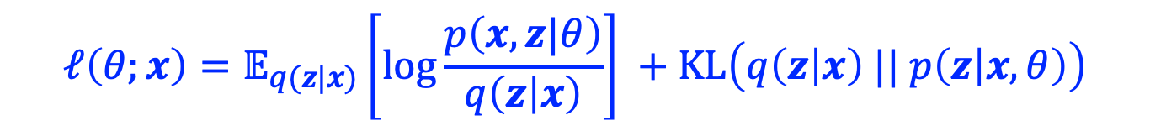
Expectation Maximization (EM)
For any distribution $q(z|x)$, define expected complete log likelihood:
Conclusion-1:
Question: show that
$$𝔼_{q}\left[ℓ_{c}\left(θ;x,z\right)\right]=\sum_{z}{q\left(z | x\right) log p(x,z|θ)}$$
$$ℓ\left(θ;x\right)≥{𝔼_{q}\left[ℓ_{c}\left(θ;x,z\right)\right]+H\left(q\right)=𝔼}_{q(z|x)}\left[log\frac{p\left(x,z|θ\right)}{q\left(z | x\right)}\right]$$
(ELBO)
$$ℓ\left(θ;x\right)=𝔼_{q(z|x)}\left[log\frac{p\left(x,z|θ\right)}{q\left(z | x\right)}\right] +KL\left(q\left(z | x\right) || p\left(z | x,θ\right)\right)$$

Slide 22

Expectation Maximization (EM)
For any distribution $q(z|x)$, define expected complete log likelihood:
Conclusion-1:
Question: show that
  Since KL divergence is non-negative, this is another way to prove Conclusion-1
$$𝔼_{q}\left[ℓ_{c}\left(θ;x,z\right)\right]=\sum_{z}{q\left(z | x\right) log p(x,z|θ)}$$
$$ℓ\left(θ;x\right)≥{𝔼_{q}\left[ℓ_{c}\left(θ;x,z\right)\right]+H\left(q\right)=𝔼}_{q(z|x)}\left[log\frac{p\left(x,z|θ\right)}{q\left(z | x\right)}\right]$$
(ELBO)
$$ℓ\left(θ;x\right)=𝔼_{q(z|x)}\left[log\frac{p\left(x,z|θ\right)}{q\left(z | x\right)}\right] +KL\left(q\left(z | x\right) || p\left(z | x,θ\right)\right)$$

Slide 23
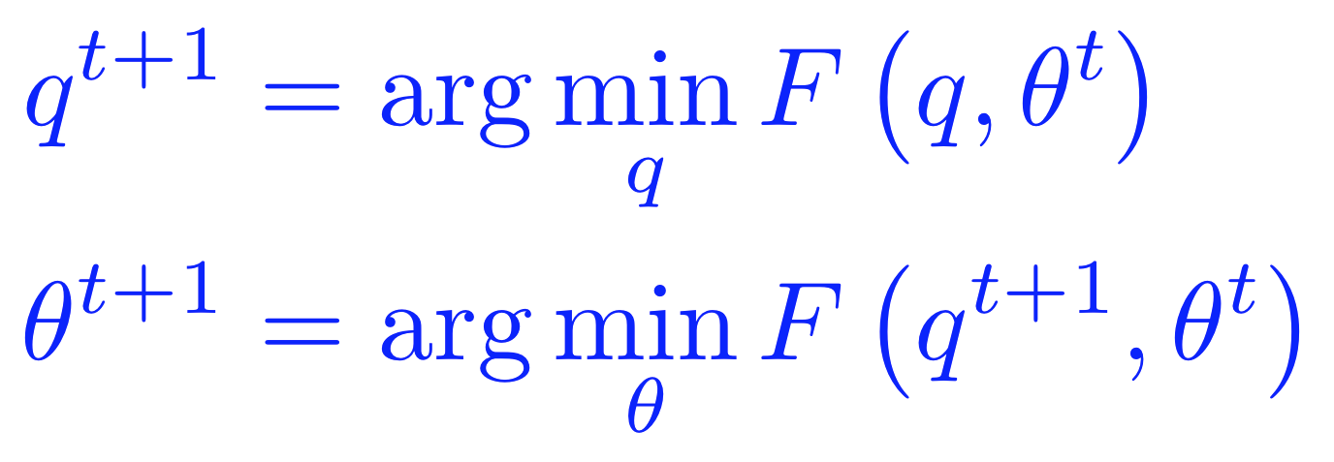

Lower Bound and Free Energy
For fixed data $x$, define a functional called the (variational) free energy:
The EM algorithm is coordinate-decent on $F$
  At each step $t$:
    E-step:
    M-step:
$$F\left(q,θ\right)={−𝔼}_{q}\left[ℓ_{c}\left(θ;x,z\right)\right]−H\left(q\right)≥−ℓ(θ;x)$$

Slide 24

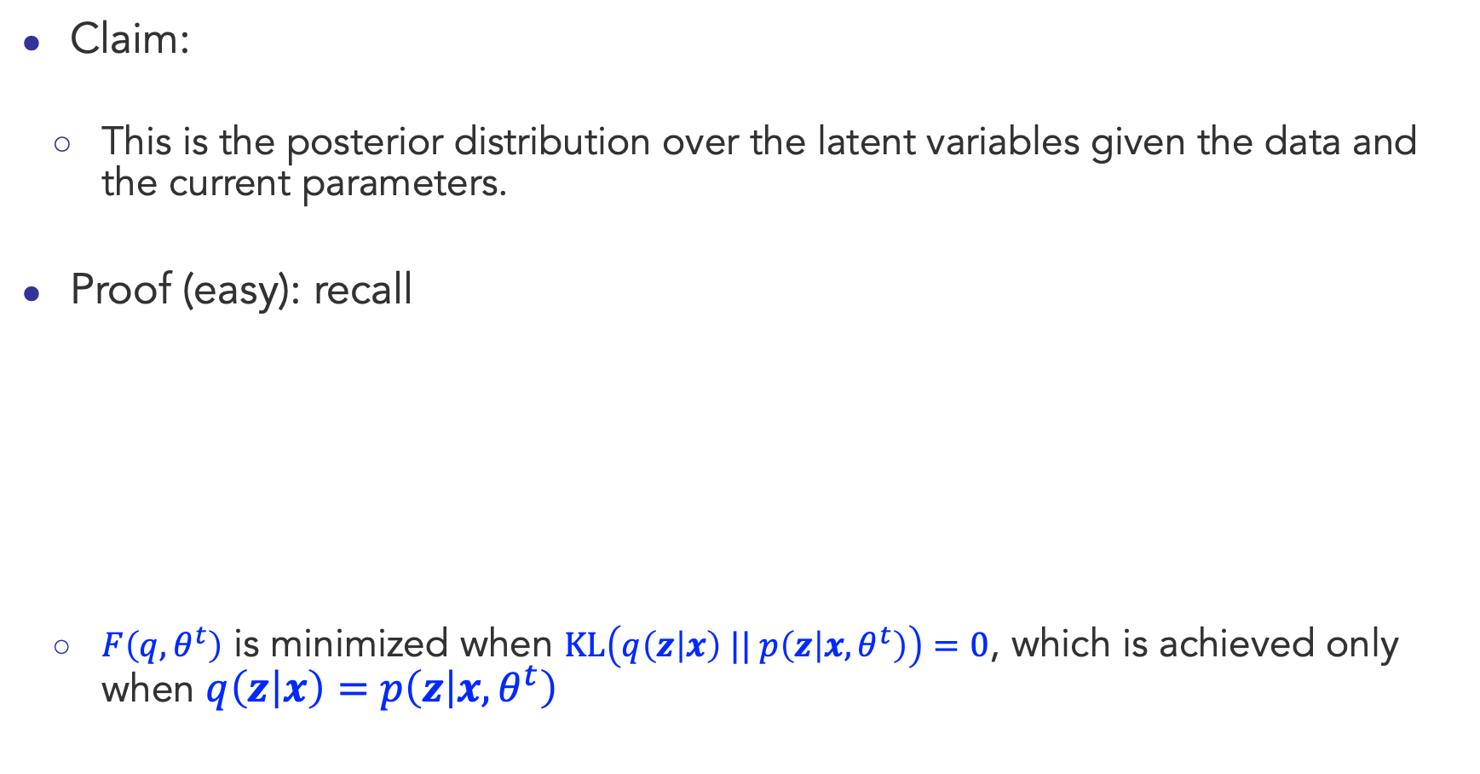

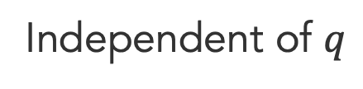
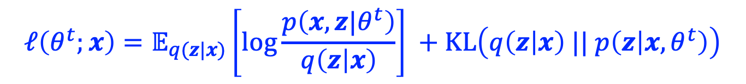
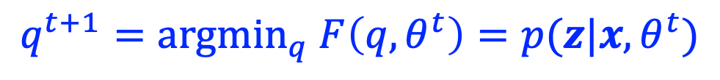
E-step: minimization of $F\left(q,θ\right)$ w.r.t $q$
Claim:
  This is the posterior distribution over the latent variables given the data and the current parameters.
Proof (easy): recall
  $F\left(q,θ^{t}\right)$ is minimized when $KL\left(q\left(z | x\right) || p\left(z | x,θ^{t}\right)\right)=0$, which is achieved only when $q\left(z | x\right)=$ $p\left(z | x,θ^{t}\right)$
$$q^{t+1}={argmin}_{q} F\left(q,θ^{t}\right)=p(z|x,θ^{t})$$
$$ℓ\left(θ^{t};x\right)=𝔼_{q(z|x)}\left[log\frac{p\left(x,z|θ^{t}\right)}{q\left(z | x\right)}\right] +KL\left(q\left(z | x\right) || p\left(z | x,θ^{t}\right)\right)$$
Independent of $q$
$$−F\left(q,θ^{t}\right)$$
$$≥0$$

Slide 25
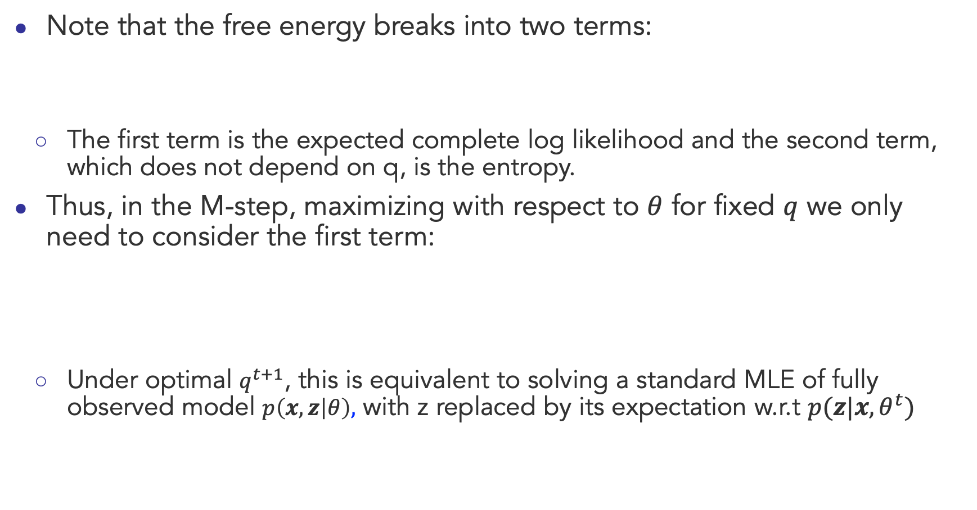
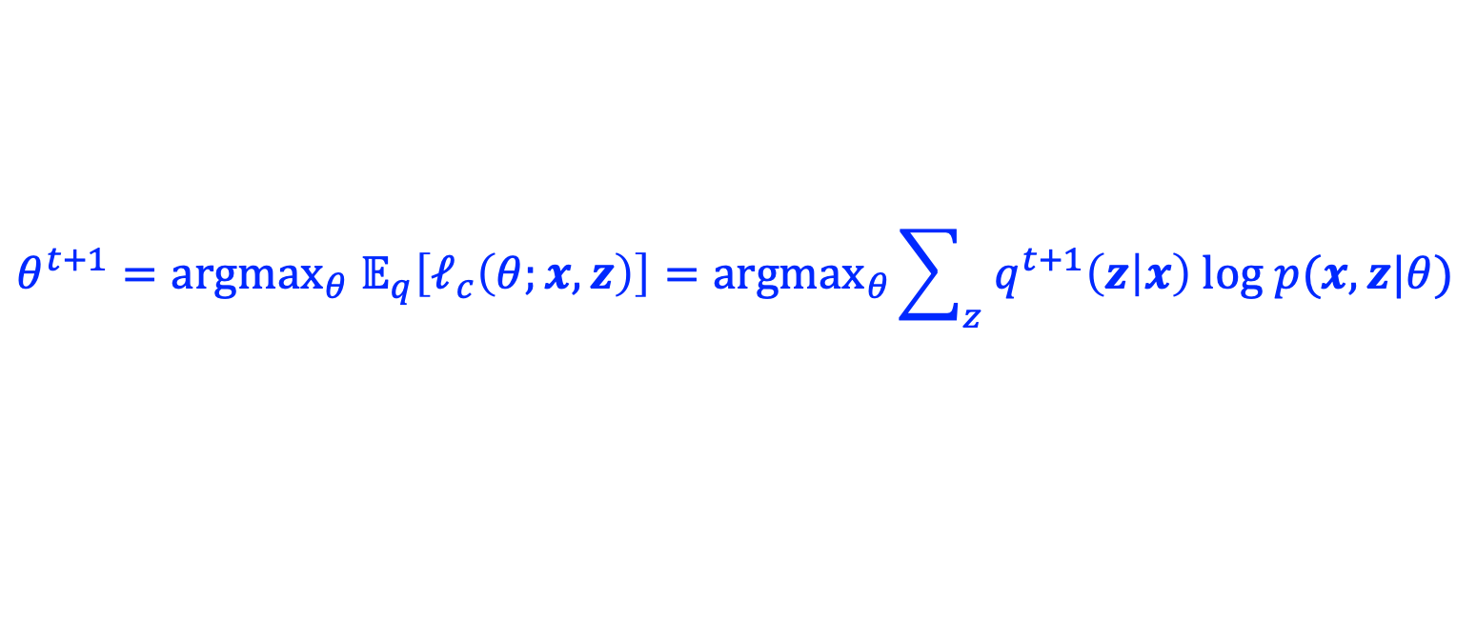
M-step: minimization of $F\left(q,θ\right)$ w.r.t $θ$
Note that the free energy breaks into two terms:
  The first term is the expected complete log likelihood and the second term, which does not depend on q, is the entropy.
Thus, in the M-step, maximizing with respect to $θ$ for fixed $q$ we only need to consider the first term:
  Under optimal $q^{t+1}$, this is equivalent to solving a standard MLE of fully observed model $p\left(x,z | θ\right),$ with z replaced by its expectation w.r.t $p(z|x,θ^{t})$
$$F\left(q,θ\right)={−𝔼}_{q}\left[ℓ_{c}\left(θ;x,z\right)\right]−H\left(q\right)≥−ℓ(θ;x)$$
$${θ^{t+1}={argmax}_{θ} 𝔼}_{q}\left[ℓ_{c}\left(θ;x,z\right)\right]={argmax}_{θ}\sum_{z}{q^{t+1}\left(z | x\right) log p(x,z|θ)}$$

Slide 26
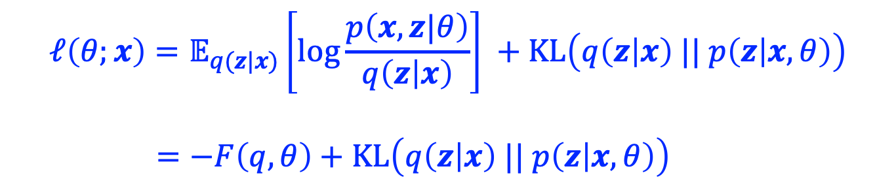


EM Algorithm: Quick Summary
Observed variables $x$, latent variables $z$
To learn a model $p\left(x,z|θ\right)$, we want to maximize the marginal log-likelihood
  But it’s too difficult
EM algorithm:
  maximize a lower bound of $ℓ\left(θ;x\right)$
  Or equivalently, minimize an upper bound of $−ℓ\left(θ;x\right)$
Key equation:
$$ℓ\left(θ;x\right)=log p\left(x | θ\right)= log\sum_{z}{p(x,z|θ)}$$
Evidence Lower Bound (ELBO)
$$ℓ\left(θ;x\right)=𝔼_{q(z|x)}\left[log\frac{p\left(x,z|θ\right)}{q\left(z | x\right)}\right] +KL\left(q\left(z | x\right) || p\left(z | x,θ\right)\right)$$
$=−F\left(q,θ\right)+KL\left(q\left(z | x\right) || p\left(z | x,θ\right)\right)$
Variational free energy

Slide 27

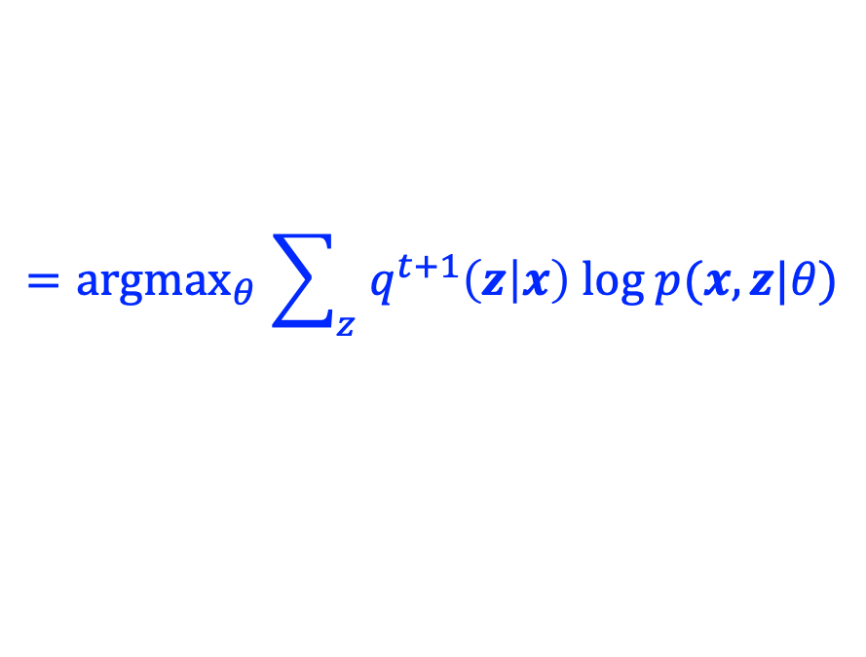
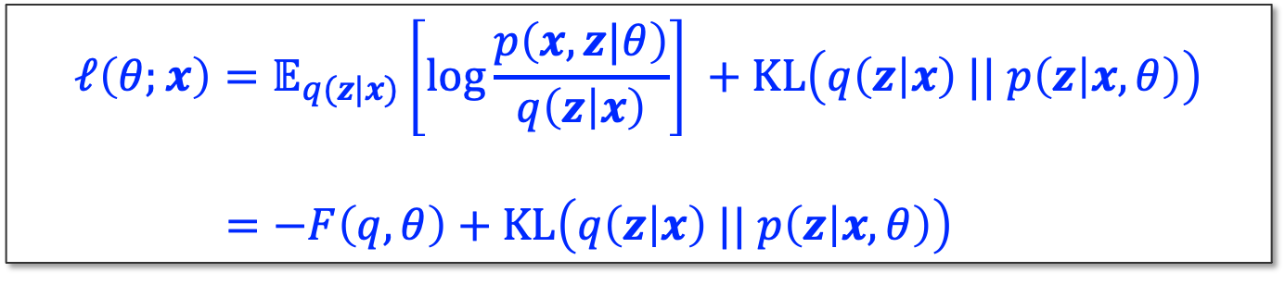
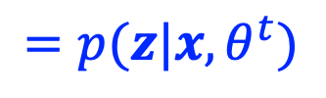
EM Algorithm: Quick Summary
The EM algorithm is coordinate-decent on $F(q,θ)$
  E-step:
    the posterior distribution over the latent variables given the data and the current parameters
  M-step:
$$=p(z|x,θ^{t})$$
$${=argmax}_{θ}\sum_{z}{q^{t+1}\left(z | x\right) log p(x,z|θ)}$$
$$ℓ\left(θ;x\right)=𝔼_{q(z|x)}\left[log\frac{p\left(x,z|θ\right)}{q\left(z | x\right)}\right] +KL\left(q\left(z | x\right) || p\left(z | x,θ\right)\right)$$
$=−F\left(q,θ\right)+KL\left(q\left(z | x\right) || p\left(z | x,θ\right)\right)$

Slide 28
Questions?

