Slide 1
DSC190: Machine Learning with Few Labels Unsupervised Learning
Zhiting Hu
Lecture 13, October 28, 2024

Slide 2
Expectation Maximization (EM): Intuition
Supervised MLE is easy:
Observe both $x$ and $z$
Unsupervised MLE is hard:
Observe only $x$
EM, intuitively:
$$\max_{θ}ℓ_{c}\left(θ;x,z\right)=log p\left(x, z | θ\right)$$
$$\max_{θ}ℓ\left(θ;x\right)=log p\left(x | θ\right)= log\sum_{z}{p(x,z|θ)}$$
We don’t actually observe q, let’s estimate it
E-step:
$$q(z|x)=p(z|x,θ)$$
M-step: ${\max_{θ} 𝔼}_{q(z|x)}\left[ log p\left(x, z | θ\right) \right]$
Let’s “pretend” we also observe $z$ (its distribution)

Slide 3
Expectation Maximization (EM): Intuition
Supervised MLE is easy:
Observe both $x$ and $z$
Unsupervised MLE is hard:
Observe only $x$
EM, intuitively:
$$\max_{θ}ℓ_{c}\left(θ;x,z\right)=log p\left(x, z | θ\right)$$
$$\max_{θ}ℓ\left(θ;x\right)=log p\left(x | θ\right)= log\sum_{z}{p(x,z|θ)}$$
We don’t actually observe q, let’s estimate it
E-step:
$$q^{t+1}(z|x)=p(z|x,θ^{t})$$
M-step: ${\max_{θ} 𝔼}_{q^{t+1}(z|x)}\left[ log p\left(x, z | θ\right) \right]$
Let’s “pretend” we also observe $z$ (its distribution)
This is an iterative process

Slide 4
Recap: Expectation Maximization (EM)
For any distribution $q(z|x)$, define expected complete log likelihood:
Conclusion-1:
Question: show that
Since KL divergence is non-negative, this is another way to prove Conclusion-1
$$𝔼_{q}\left[ℓ_{c}\left(θ;x,z\right)\right]=\sum_{z}{q\left(z | x\right) log p(x,z|θ)}$$
$$ℓ\left(θ;x\right)≥{𝔼_{q}\left[ℓ_{c}\left(θ;x,z\right)\right]+H\left(q\right)=𝔼}_{q(z|x)}\left[log\frac{p\left(x,z|θ\right)}{q\left(z | x\right)}\right]$$
(ELBO)
$$ℓ\left(θ;x\right)=𝔼_{q(z|x)}\left[log\frac{p\left(x,z|θ\right)}{q\left(z | x\right)}\right] +KL\left(q\left(z | x\right) || p\left(z | x,θ\right)\right)$$

Slide 5
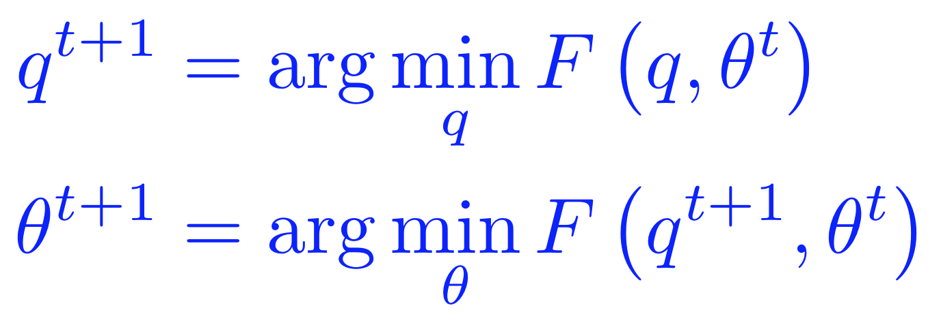
Lower Bound and Free Energy
For fixed data $x$, define a functional called the (variational) free energy:
The EM algorithm is coordinate-decent on $F$
At each step $t$:
E-step:
M-step:
$$F\left(q,θ\right)={−𝔼}_{q}\left[ℓ_{c}\left(θ;x,z\right)\right]−H\left(q\right)≥−ℓ(θ;x)$$

Slide 6
E-step: minimization of $F\left(q,θ\right)$ w.r.t $q$
Question: show that that optimal solution of E-step is
I.e., the posterior distribution over the latent variables given the data and the current parameters.
Hint: use the fact
$$q^{t+1}={argmin}_{q} F\left(q,θ^{t}\right)=p(z|x,θ^{t})$$
Evidence Lower Bound (ELBO)
$$ℓ\left(θ;x\right)=𝔼_{q(z|x)}\left[log\frac{p\left(x,z|θ\right)}{q\left(z | x\right)}\right] +KL\left(q\left(z | x\right) || p\left(z | x,θ\right)\right)$$
$=−F\left(q,θ\right)+KL\left(q\left(z | x\right) || p\left(z | x,θ\right)\right)$
Variational free energy

Slide 7
E-step: minimization of $F\left(q,θ\right)$ w.r.t $q$
Claim:
This is the posterior distribution over the latent variables given the data and the current parameters.
Proof (easy): recall
$F\left(q,θ^{t}\right)$ is minimized when $KL\left(q\left(z | x\right) || p\left(z | x,θ^{t}\right)\right)=0$, which is achieved only when $q\left(z | x\right)=$ $p\left(z | x,θ^{t}\right)$
$$q^{t+1}={argmin}_{q} F\left(q,θ^{t}\right)=p(z|x,θ^{t})$$
$$ℓ\left(θ^{t};x\right)=𝔼_{q(z|x)}\left[log\frac{p\left(x,z|θ^{t}\right)}{q\left(z | x\right)}\right] +KL\left(q\left(z | x\right) || p\left(z | x,θ^{t}\right)\right)$$
Independent of $q$
$$−F\left(q,θ^{t}\right)$$
$$≥0$$

Slide 8
M-step: minimization of $F\left(q,θ\right)$ w.r.t $θ$
Note that the free energy breaks into two terms:
The first term is the expected complete log likelihood and the second term, which does not depend on q, is the entropy.
Thus, in the M-step, maximizing with respect to $θ$ for fixed $q$ we only need to consider the first term:
Under optimal $q^{t+1}$, this is equivalent to solving a standard MLE of fully observed model $p\left(x,z | θ\right),$ with z replaced by its expectation w.r.t $p(z|x,θ^{t})$
$$F\left(q,θ\right)={−𝔼}_{q}\left[ℓ_{c}\left(θ;x,z\right)\right]−H\left(q\right)≥−ℓ(θ;x)$$
$${θ^{t+1}={argmax}_{θ} 𝔼}_{q}\left[ℓ_{c}\left(θ;x,z\right)\right]={argmax}_{θ}\sum_{z}{q^{t+1}\left(z | x\right) log p(x,z|θ)}$$

Slide 9
EM Algorithm: Quick Summary
Observed variables $x$, latent variables $z$
To learn a model $p\left(x,z|θ\right)$, we want to maximize the marginal log-likelihood
But it’s too difficult
EM algorithm:
maximize a lower bound of $ℓ\left(θ;x\right)$
Or equivalently, minimize an upper bound of $−ℓ\left(θ;x\right)$
Key equation:
$$ℓ\left(θ;x\right)=log p\left(x | θ\right)= log\sum_{z}{p(x,z|θ)}$$
Evidence Lower Bound (ELBO)
$$ℓ\left(θ;x\right)=𝔼_{q(z|x)}\left[log\frac{p\left(x,z|θ\right)}{q\left(z | x\right)}\right] +KL\left(q\left(z | x\right) || p\left(z | x,θ\right)\right)$$
$=−F\left(q,θ\right)+KL\left(q\left(z | x\right) || p\left(z | x,θ\right)\right)$
Variational free energy

Slide 10
EM Algorithm: Quick Summary
The EM algorithm is coordinate-decent on $F(q,θ)$
E-step:
the posterior distribution over the latent variables given the data and the current parameters
M-step:
$$=p(z|x,θ^{t})$$
$${=argmax}_{θ}\sum_{z}{q^{t+1}\left(z | x\right) log p(x,z|θ)}$$
$$ℓ\left(θ;x\right)=𝔼_{q(z|x)}\left[log\frac{p\left(x,z|θ\right)}{q\left(z | x\right)}\right] +KL\left(q\left(z | x\right) || p\left(z | x,θ\right)\right)$$
$=−F\left(q,θ\right)+KL\left(q\left(z | x\right) || p\left(z | x,θ\right)\right)$

Slide 11
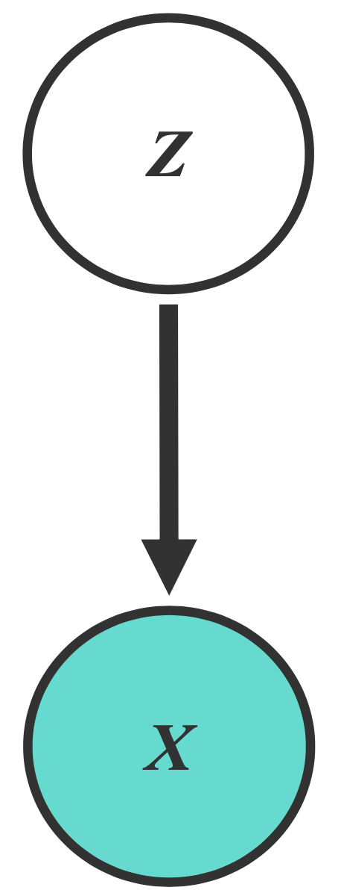
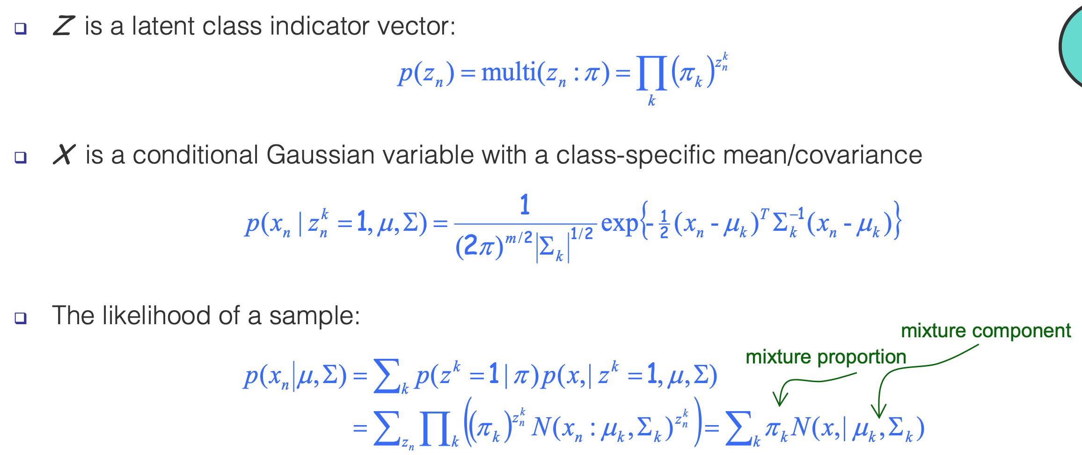
Example: Gaussian Mixture Models (GMMs)
Consider a mixture of K Gaussian components:

Slide 12
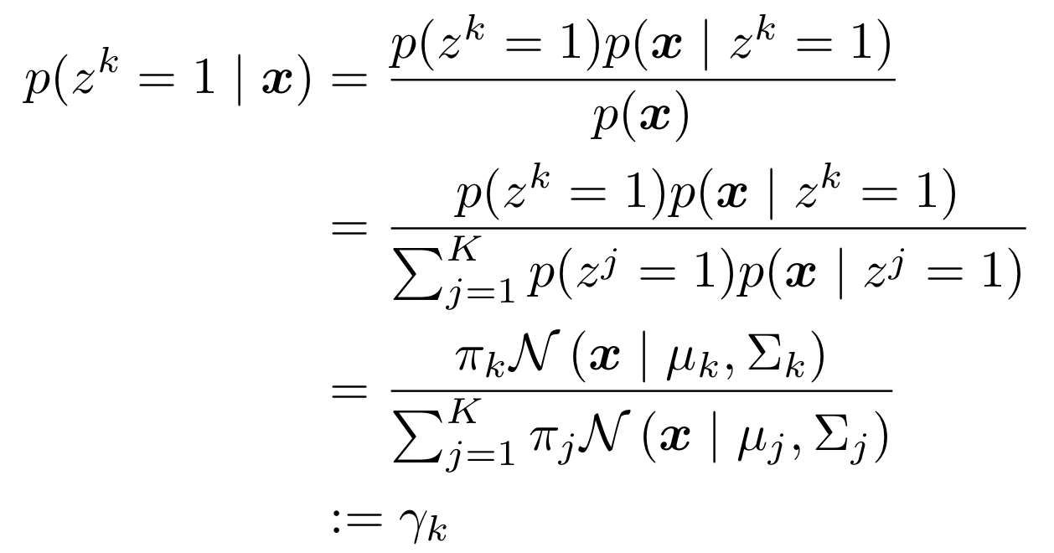
Example: Gaussian Mixture Models (GMMs)
E-step: computing the posterior of $z_{n}$ given the current estimate of the parameters (i.e., $π , μ, Σ$)

Slide 13
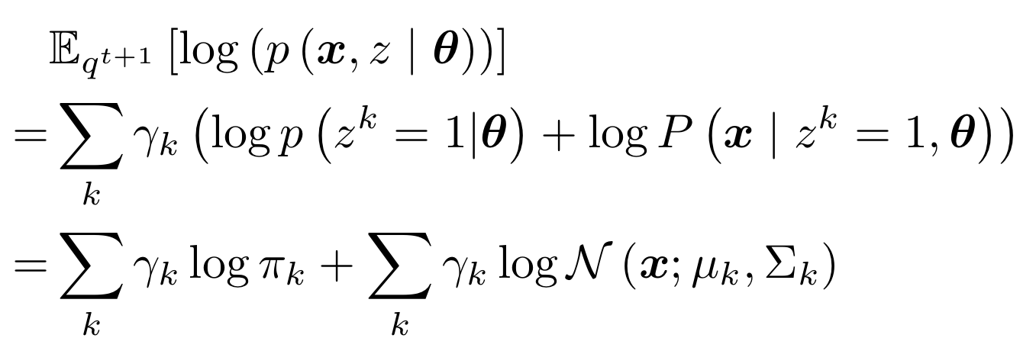
Example: Gaussian Mixture Models (GMMs)
M-step: computing the parameters given the current estimate of $z_{n}$
Once we have $q^{t+1}\left(z^{k} | x\right)=p\left(z^{k} | x,θ^{t}\right)=γ^{k}$, we can compute the expected likelihood:
We need to fit $K$ Gaussians, just need to weight examples by $γ_{k}$
$${θ^{t+1}=argmax}_{θ}\sum_{k}{q^{t+1}\left(z^{k}=1 | x\right) log p(x,z^{k}=1|θ)}$$

Slide 14
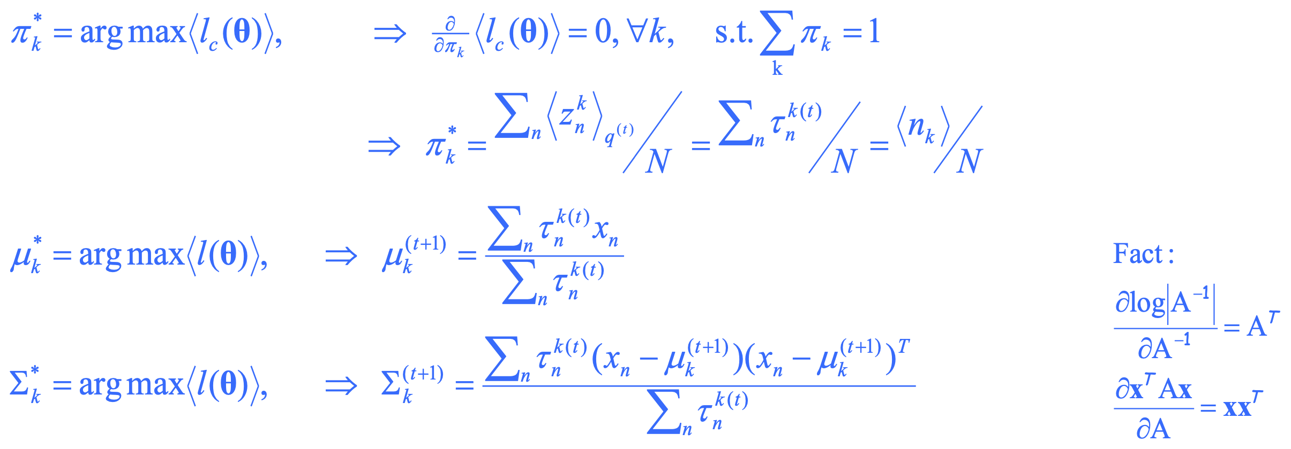
Example: Gaussian Mixture Models (GMMs)
M-step: computing the parameters given the current estimate of $z_{n}$

Slide 15
EM Algorithm for GMM: Quick Summary
Initialize the means $μ_{k}$ , covariances $Σ_{k}$ and mixing coefficients $π_{k}$
Iterate until convergence:
E-step: Evaluate the posterior given current parameters
M-step: Re-estimate the parameters given current posterior

Slide 16
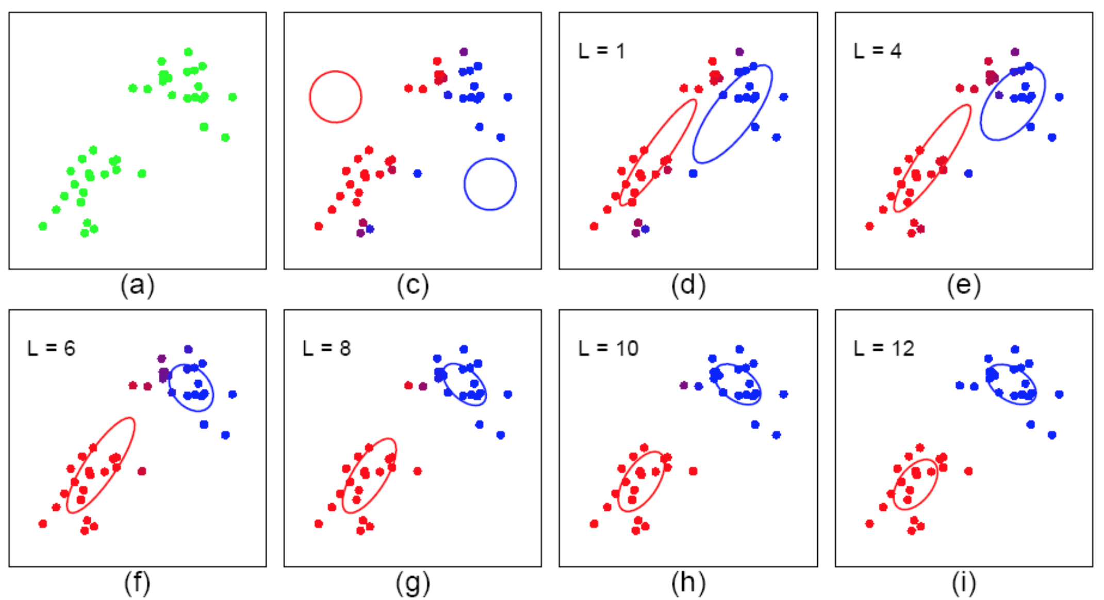
Example: Gaussian Mixture Models (GMMs)
Start: “guess” the centroid $μ_{k}$ and covariance $Σ_{k}$ of each of the K clusters
Loop:

Slide 17
Summary: EM Algorithm
A way of maximizing likelihood function for latent variable models. Finds MLE of parameters when the original (hard) problem can be broken up into two (easy) pieces
Estimate some “missing” or “unobserved” data from observed data and current parameters.
Using this “complete” data, find the maximum likelihood parameter estimates.

Slide 18
Summary: EM Algorithm
The EM algorithm is coordinate-decent on $F(q,θ)$
E-step:
M-step:
$$=p(z|x,θ^{t})$$
$${=argmax}_{θ}\sum_{z}{q^{t+1}\left(z | x\right) log p(x,z|θ)}$$
$$ℓ\left(θ;x\right)=𝔼_{q(z|x)}\left[log\frac{p\left(x,z|θ\right)}{q\left(z | x\right)}\right] +KL\left(q\left(z | x\right) || p\left(z | x,θ\right)\right)$$
$=−F\left(q,θ\right)+KL\left(q\left(z | x\right) || p\left(z | x,θ\right)\right)$

Slide 19
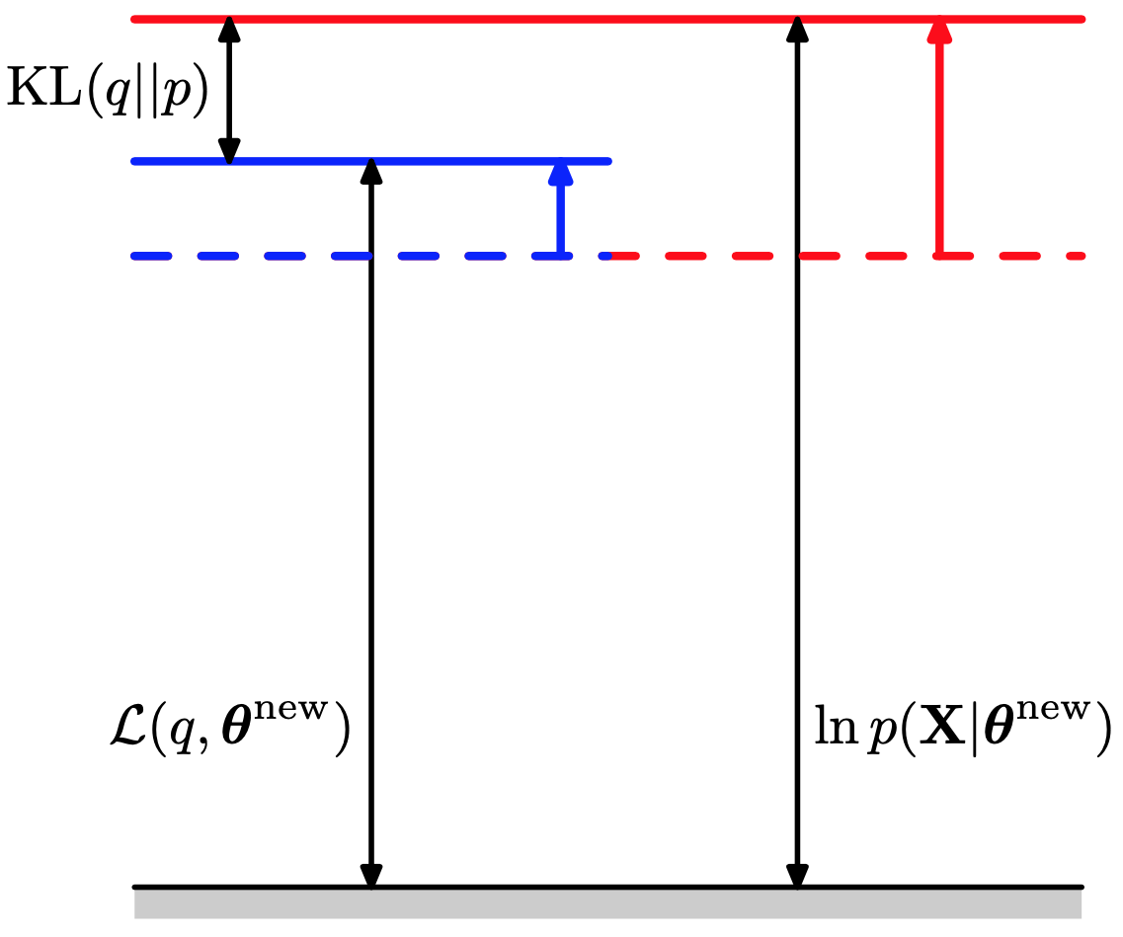
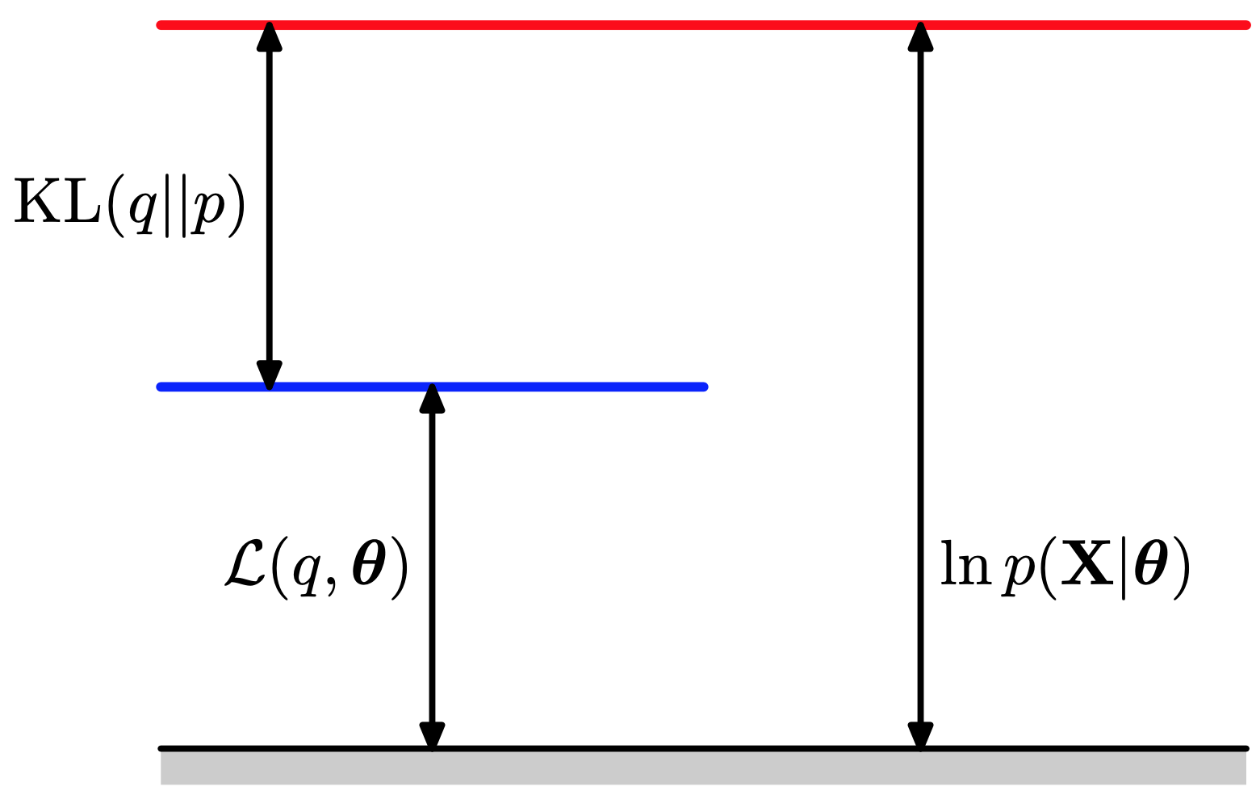
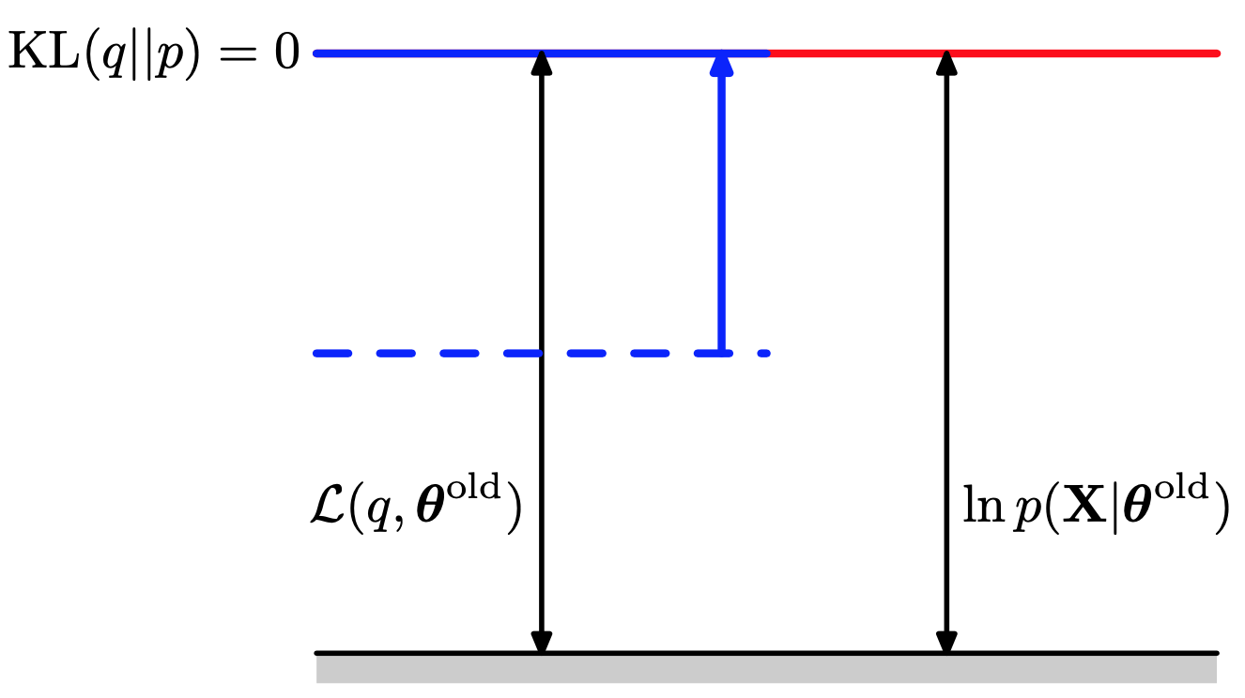
Each EM iteration guarantees to improve the likelihood
$$ℓ\left(θ;x\right)=𝔼_{q(z|x)}\left[log\frac{p\left(x,z|θ\right)}{q\left(z | x\right)}\right] +KL\left(q\left(z | x\right) || p\left(z | x,θ\right)\right)$$
E-step
M-step
[PRML, Chap 9.4]

Slide 20
Summary: EM Algorithm
The EM algorithm is coordinate-decent on $F(q,θ)$
E-step:
M-step:
Limitation: need to be able to compute $p\left(z | x,θ\right)$, not possible for more complicated models --- solution: Variational inference
$$=p(z|x,θ^{t})$$
$${=argmax}_{θ}\sum_{z}{q^{t+1}\left(z | x\right) log p(x,z|θ)}$$
$$ℓ\left(θ;x\right)=𝔼_{q(z|x)}\left[log\frac{p\left(x,z|θ\right)}{q\left(z | x\right)}\right] +KL\left(q\left(z | x\right) || p\left(z | x,θ\right)\right)$$
$=−F\left(q,θ\right)+KL\left(q\left(z | x\right) || p\left(z | x,θ\right)\right)$

Slide 21
Questions?

