Slide 1
DSC190: Machine Learning with Few Labels Unsupervised Learning
Zhiting Hu
Lecture 10, October 21, 2024

Slide 2
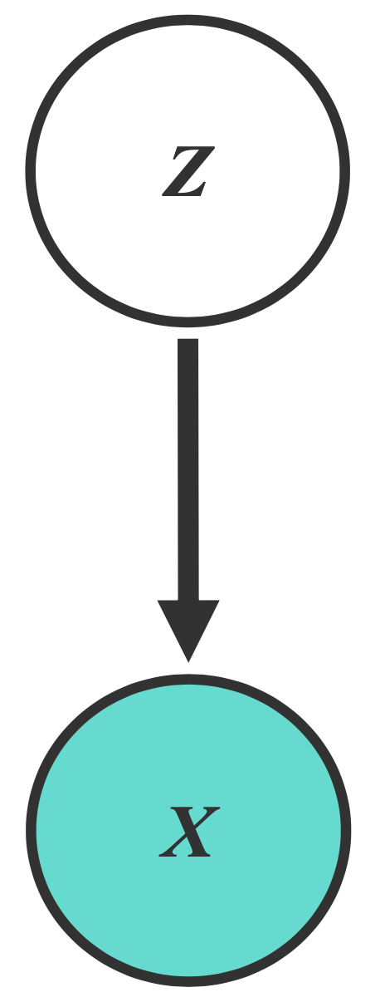
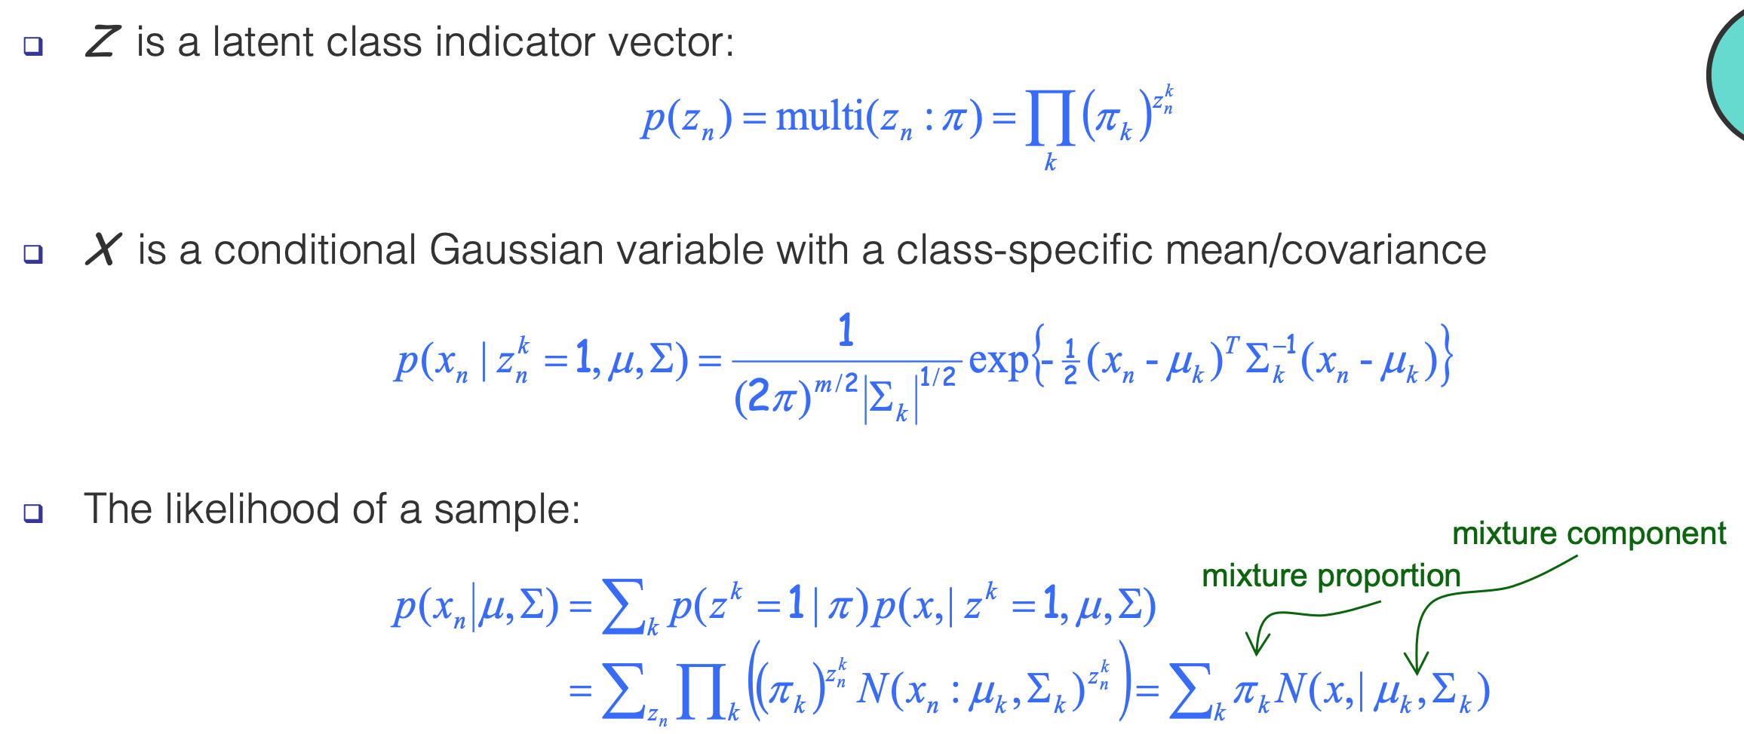
Recap: Gaussian Mixture Models (GMMs)
Consider a mixture of K Gaussian components:
Parameters to be learned:
Notes:
Parameters to be learned: mixture proportion, mixture components

Slide 3
Recap: Why is Learning Harder?
Complete log likelihood: if both $x$ and $z$ can be observed, then
Incomplete (or marginal) log likelihood: with $z$ unobserved, our objective becomes the log of a marginal probability:
$$ℓ_{c}\left(θ;x,z\right)=log p\left(x, z | θ\right)= log p\left(z | θ_{z}\right)+log p(x|z,θ_{x})$$
GMMs:
$$log p\left(x_{n},z_{n} | μ, Σ\right)= log$$
$$ℓ\left(θ;x\right)=log p\left(x | θ\right)= log\sum_{z}{p(x,z|θ)}$$
GMMs:
$$log p\left(x_{n} | μ, Σ\right)= log$$

Slide 4
Expectation Maximization (EM): Intuition
Supervised MLE is easy:
Observe both $x$ and $z$
Unsupervised MLE is hard:
Observe only $x$
EM, intuitively:
$$\max_{θ}ℓ_{c}\left(θ;x,z\right)=log p\left(x, z | θ\right)$$
$$\max_{θ}ℓ\left(θ;x\right)=log p\left(x | θ\right)= log\sum_{z}{p(x,z|θ)}$$
We don’t actually observe q, let’s estimate it
E-step:
$$q(z|x)=p(z|x,θ)$$
M-step: ${\max_{θ} 𝔼}_{q(z|x)}\left[ log p\left(x, z | θ\right) \right]$
Let’s “pretend” we also observe $z$ (its distribution)

Slide 5
Expectation Maximization (EM): Intuition
Supervised MLE is easy:
Observe both $x$ and $z$
Unsupervised MLE is hard:
Observe only $x$
EM, intuitively:
$$\max_{θ}ℓ_{c}\left(θ;x,z\right)=log p\left(x, z | θ\right)$$
$$\max_{θ}ℓ\left(θ;x\right)=log p\left(x | θ\right)= log\sum_{z}{p(x,z|θ)}$$
We don’t actually observe q, let’s estimate it
E-step:
$$q^{t+1}(z|x)=p(z|x,θ^{t})$$
M-step: ${\max_{θ} 𝔼}_{q^{t+1}(z|x)}\left[ log p\left(x, z | θ\right) \right]$
Let’s “pretend” we also observe $z$ (its distribution)
This is an iterative process

Slide 6
Expectation Maximization (EM)
For any distribution $q(z|x)$, define expected complete log likelihood:
A deterministic function of $θ$
Inherit the factorizability of $ℓ_{c}\left(θ;x,z\right)$
Use this as the surrogate objective
Does maximizing this surrogate yield a maximizer of the likelihood?
We can show that:
$$𝔼_{q}\left[ℓ_{c}\left(θ;x,z\right)\right]=\sum_{z}{q\left(z | x\right) log p(x,z|θ)}$$
$ℓ\left(θ;x\right)≥$ $𝔼_{q}\left[ℓ_{c}\left(θ;x,z\right)\right]+H\left(q\right)$

Slide 7
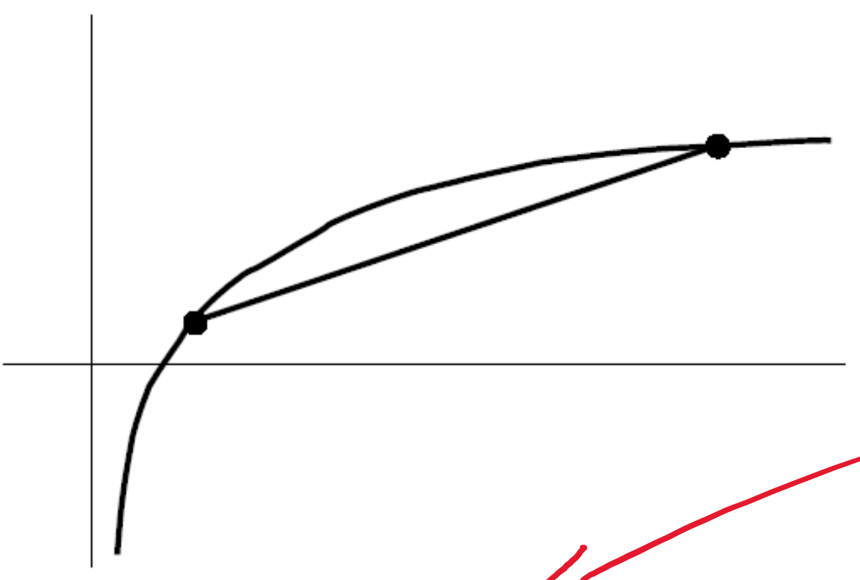
Expectation Maximization (EM)
For any distribution $q(z|x)$, define expected complete log likelihood:
Question: show that
Hint: a useful inequality: Jensen’s inequality
If $f$ is convex:
$$𝔼_{q}\left[ℓ_{c}\left(θ;x,z\right)\right]=\sum_{z}{q\left(z | x\right) log p(x,z|θ)}$$
$ℓ\left(θ;x\right)≥$ $𝔼_{q}\left[ℓ_{c}\left(θ;x,z\right)\right]+H\left(q\right)$
$$𝔼_{p(y)}\left[f(y)\right]≥f(𝔼_{p(y)}[y])$$

Slide 8
Expectation Maximization (EM)
For any distribution $q(z|x)$, define expected complete log likelihood:
Question: show that
$$𝔼_{q}\left[ℓ_{c}\left(θ;x,z\right)\right]=\sum_{z}{q\left(z | x\right) log p(x,z|θ)}$$
$ℓ\left(θ;x\right)≥$ $𝔼_{q}\left[ℓ_{c}\left(θ;x,z\right)\right]+H\left(q\right)$

Slide 9
Expectation Maximization (EM)
For any distribution $q(z|x)$, define expected complete log likelihood:
Question: show that
$$𝔼_{q}\left[ℓ_{c}\left(θ;x,z\right)\right]=\sum_{z}{q\left(z | x\right) log p(x,z|θ)}$$
$ℓ\left(θ;x\right)≥$ $𝔼_{q}\left[ℓ_{c}\left(θ;x,z\right)\right]+H\left(q\right)$

Slide 10
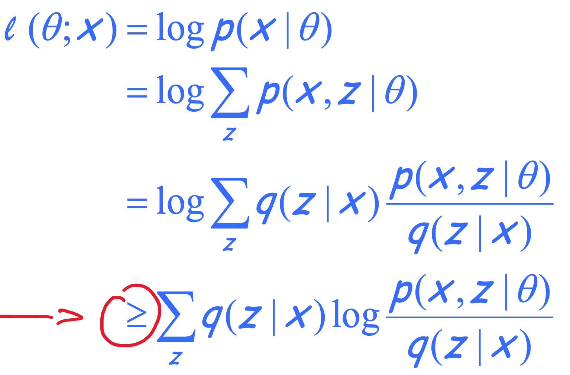
Expectation Maximization (EM)
For any distribution $q(z|x)$, define expected complete log likelihood:
Jensen’s inequality
$$𝔼_{q}\left[ℓ_{c}\left(θ;x,z\right)\right]=\sum_{z}{q\left(z | x\right) log p(x,z|θ)}$$
$$≥$$
Evidence Lower Bound (ELBO)
$$=𝔼_{q}\left[ℓ_{c}\left(θ;x,z\right)\right]+H\left(q\right)$$

Slide 11
Expectation Maximization (EM)
For any distribution $q(z|x)$, define expected complete log likelihood:
Conclusion-1:
Question: show that
$$𝔼_{q}\left[ℓ_{c}\left(θ;x,z\right)\right]=\sum_{z}{q\left(z | x\right) log p(x,z|θ)}$$
$$ℓ\left(θ;x\right)≥{𝔼_{q}\left[ℓ_{c}\left(θ;x,z\right)\right]+H\left(q\right)=𝔼}_{q(z|x)}\left[log\frac{p\left(x,z|θ\right)}{q\left(z | x\right)}\right]$$
(ELBO)
$$ℓ\left(θ;x\right)=𝔼_{q(z|x)}\left[log\frac{p\left(x,z|θ\right)}{q\left(z | x\right)}\right] +KL\left(q\left(z | x\right) || p\left(z | x,θ\right)\right)$$

Slide 12
Expectation Maximization (EM)
For any distribution $q(z|x)$, define expected complete log likelihood:
Conclusion-1:
Question: show that
Since KL divergence is non-negative, this is another way to prove Conclusion-1
$$𝔼_{q}\left[ℓ_{c}\left(θ;x,z\right)\right]=\sum_{z}{q\left(z | x\right) log p(x,z|θ)}$$
$$ℓ\left(θ;x\right)≥{𝔼_{q}\left[ℓ_{c}\left(θ;x,z\right)\right]+H\left(q\right)=𝔼}_{q(z|x)}\left[log\frac{p\left(x,z|θ\right)}{q\left(z | x\right)}\right]$$
(ELBO)
$$ℓ\left(θ;x\right)=𝔼_{q(z|x)}\left[log\frac{p\left(x,z|θ\right)}{q\left(z | x\right)}\right] +KL\left(q\left(z | x\right) || p\left(z | x,θ\right)\right)$$

Slide 13
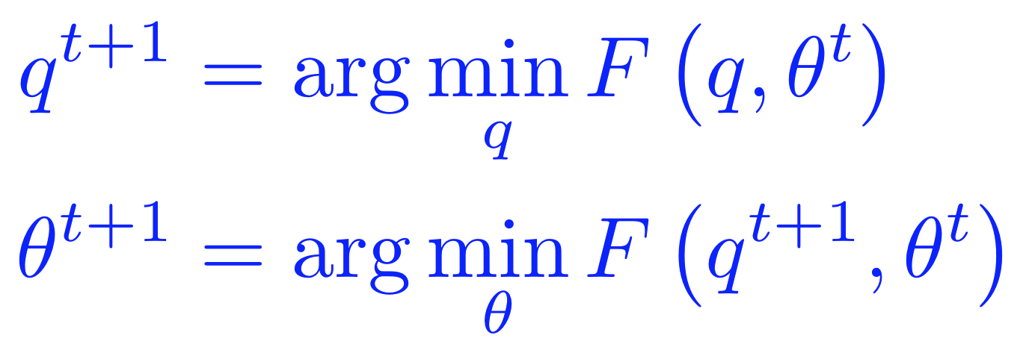
Lower Bound and Free Energy
For fixed data $x$, define a functional called the (variational) free energy:
The EM algorithm is coordinate-decent on $F$
At each step $t$:
E-step:
M-step:
$$F\left(q,θ\right)={−𝔼}_{q}\left[ℓ_{c}\left(θ;x,z\right)\right]−H\left(q\right)≥−ℓ(θ;x)$$

Slide 14
E-step: minimization of $F\left(q,θ\right)$ w.r.t $q$
Question: show that that optimal solution of E-step is
I.e., the posterior distribution over the latent variables given the data and the current parameters.
Hint: use the fact
$$q^{t+1}={argmin}_{q} F\left(q,θ^{t}\right)=p(z|x,θ^{t})$$
Evidence Lower Bound (ELBO)
$$ℓ\left(θ;x\right)=𝔼_{q(z|x)}\left[log\frac{p\left(x,z|θ\right)}{q\left(z | x\right)}\right] +KL\left(q\left(z | x\right) || p\left(z | x,θ\right)\right)$$
$=−F\left(q,θ\right)+KL\left(q\left(z | x\right) || p\left(z | x,θ\right)\right)$
Variational free energy

Slide 15
E-step: minimization of $F\left(q,θ\right)$ w.r.t $q$
Claim:
This is the posterior distribution over the latent variables given the data and the current parameters.
Proof (easy): recall
$F\left(q,θ^{t}\right)$ is minimized when $KL\left(q\left(z | x\right) || p\left(z | x,θ^{t}\right)\right)=0$, which is achieved only when $q\left(z | x\right)=$ $p\left(z | x,θ^{t}\right)$
$$q^{t+1}={argmin}_{q} F\left(q,θ^{t}\right)=p(z|x,θ^{t})$$
$$ℓ\left(θ^{t};x\right)=𝔼_{q(z|x)}\left[log\frac{p\left(x,z|θ^{t}\right)}{q\left(z | x\right)}\right] +KL\left(q\left(z | x\right) || p\left(z | x,θ^{t}\right)\right)$$
Independent of $q$
$$−F\left(q,θ^{t}\right)$$
$$≥0$$

Slide 16
M-step: minimization of $F\left(q,θ\right)$ w.r.t $θ$
Note that the free energy breaks into two terms:
The first term is the expected complete log likelihood and the second term, which does not depend on q, is the entropy.
Thus, in the M-step, maximizing with respect to $θ$ for fixed $q$ we only need to consider the first term:
Under optimal $q^{t+1}$, this is equivalent to solving a standard MLE of fully observed model $p\left(x,z | θ\right),$ with z replaced by its expectation w.r.t $p(z|x,θ^{t})$
$$F\left(q,θ\right)={−𝔼}_{q}\left[ℓ_{c}\left(θ;x,z\right)\right]−H\left(q\right)≥−ℓ(θ;x)$$
$${θ^{t+1}={argmax}_{θ} 𝔼}_{q}\left[ℓ_{c}\left(θ;x,z\right)\right]={argmax}_{θ}\sum_{z}{q^{t+1}\left(z | x\right) log p(x,z|θ)}$$

Slide 17
EM Algorithm: Quick Summary
Observed variables $x$, latent variables $z$
To learn a model $p\left(x,z|θ\right)$, we want to maximize the marginal log-likelihood
But it’s too difficult
EM algorithm:
maximize a lower bound of $ℓ\left(θ;x\right)$
Or equivalently, minimize an upper bound of $−ℓ\left(θ;x\right)$
Key equation:
$$ℓ\left(θ;x\right)=log p\left(x | θ\right)= log\sum_{z}{p(x,z|θ)}$$
Evidence Lower Bound (ELBO)
$$ℓ\left(θ;x\right)=𝔼_{q(z|x)}\left[log\frac{p\left(x,z|θ\right)}{q\left(z | x\right)}\right] +KL\left(q\left(z | x\right) || p\left(z | x,θ\right)\right)$$
$=−F\left(q,θ\right)+KL\left(q\left(z | x\right) || p\left(z | x,θ\right)\right)$
Variational free energy

Slide 18
EM Algorithm: Quick Summary
The EM algorithm is coordinate-decent on $F(q,θ)$
E-step:
the posterior distribution over the latent variables given the data and the current parameters
M-step:
$$=p(z|x,θ^{t})$$
$${=argmax}_{θ}\sum_{z}{q^{t+1}\left(z | x\right) log p(x,z|θ)}$$
$$ℓ\left(θ;x\right)=𝔼_{q(z|x)}\left[log\frac{p\left(x,z|θ\right)}{q\left(z | x\right)}\right] +KL\left(q\left(z | x\right) || p\left(z | x,θ\right)\right)$$
$=−F\left(q,θ\right)+KL\left(q\left(z | x\right) || p\left(z | x,θ\right)\right)$

Slide 19
Questions?

